Slide 1
Learning to Program in Python
Concept 3
STRINGS
Notes:
Strings are a form of data type.
The main Learning Outcomes (LO) achieved are highlighted throughout the lesson and tasks.
The list is not exhaustive, and consultation with the LCCS spec is encouraged at all times throughout the implementation of the course.

Slide 2
Learning Intentions
From this lesson the students will be able to:
Understand the concept of a string
Retrieve and Replace characters in strings
Slice a string into sub-strings
Write strings to a file
LO 2.16 students should be able to use data types that are common to procedural high-level languages
Notes:
The skills learned to analyse and create strings will serve the students well for conditional statements and also for learning lists.

Slide 3
STRINGS
Our very first line of code we wrote in the IDE was:
“hello world” is an example of a string.
You can enclose it in single quotes also.
(‘hello world’)
Notes:
Link to very first use of python in class. Encourage use of double quotes.

Slide 4
STRINGS
A string is a data type.
Each individual member of a string is a character such as “A” or “1” or “!” or “ “.
(These characters are in fact strings of length 1)
Notes:
Emphasise the first index is ZERO and strings are a form of data type ….. Very popular type in Python

Slide 5
STRINGS
The characters can be accessed by their index or place in the string.
The first index is ZERO
Let’s try some examples in your IDE
Notes:
Emphasise the first index is ZERO and strings are a form of data type ….. All basic input and output in Python is in the form of strings

Slide 6
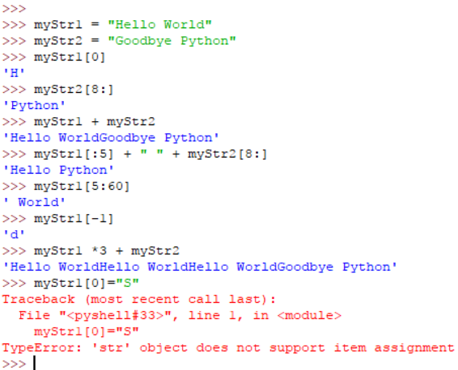
Go to your shell (IDE) and figure out some of these String Methods
LO 2.20 students should be able to identify and fix/debug warnings and errors in computer code and modify as required
Notes:
Highlight slicing [5:9] or [:4] etc….. Addition of strings …….. And strings are fixed or immutable

Slide 7
Notice that the last command below reports an error.
The string cannot be assigned a value in this way.
Strings are said to be IMMUTABLE.
(See the Python Docs in your Python Shell. Go to the Tutorial)
Notes:
Allow students time to preview the Python Docs and especially The Python Tutorial.
So to change a string you must make a copy, and change it as you construct the new string.

Slide 8
Escape Characters( \ )
Remember : If we want to print a string and then on the next line print another string we use the backslash followed by the letter n.
print(“First Line.\nSecond Line.”)
(backslash (\) is known as an escape character in Python)
Notes:
Encourage the students to experiment and continue to research the Python Docs -> Tutorial -> Strings

Slide 9
Escape Characters( \ )
“\t” Inserts a tab for example
“\”” The backslash here escapes the quotes and so this would print out a set of quotes.
(See the Strings section in Python Docs Tutorials.)
Notes:
Encourage the students to experiment and continue to research the Python Docs -> Tutorial -> Strings

Slide 10
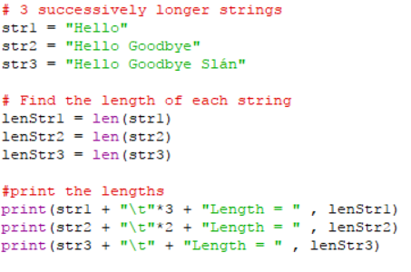
Length of a String (Len)
A very useful function in programming is finding the Length of a string. Try the code below.
LO 1.22 students should be able to read, write, test, and modify computer programs
Notes:
Encourage the students to type in this code, save in a file in their storage space, and edit and experiment

Slide 11
a = ‘Happy’ b = ‘Birthday’
+ | Concatenation | a + b gives ‘HappyBirthday’
* | Repetition | a * 3 gives ‘HappyHappyHappy’
[] | Slice | b[1] gives ‘i’
[:] | Range Slice | a[:2] + b[5:] gives ‘Haday’
= | Assignment | c = b gives c =‘Birthday’ and c is separate from b.
+= | Assignment & concatenation | c += ‘ Boy’ gives c as ‘Birthday Boy’
in | Membership | ‘p’ in a gives True (or 1) ‘q’ in a gives False (or 0)
False
‘t’ in a gives ?
Notes:
The word descriptions of the operations are important. (Slice, Concatenation, Assignment, etc….)
Encourage students to predict the outcomes. The PRIMM method will encourage engagement. (Predict Run Investigate Modify Make)
The assignment and concat are useful for the solution to the next challenge.

Slide 12
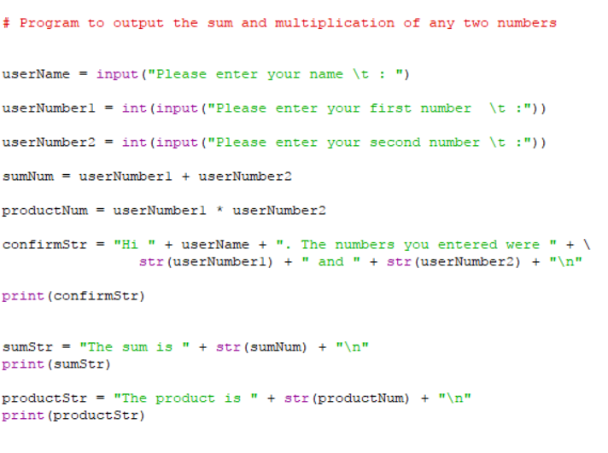
What line of code could be behind me?
What line of code is behind me?
What line of code could be behind me?
Notes:
Encourage the students to type in this code, save in a file in their storage space, and edit and experiment.
They need to read all the lines of code first, especially the last 3 in order to figure out the lines that are hidden.

Slide 13
CHALLENGE
1. Ask the user to type in a 4 letter word
For example “mart”
2. If the length of the word is not 4, ask user again.
Reverse the string and output as a new string
From the example above : “tram”
LO 1.7 students should be able to develop algorithms to implement chosen solutions
Notes:
Ask the students to perform this task …. The assumption at this point is they have not studied loops; when loops are studied, this can be re-visited.
The Scratch symbol indicates that this task should also be done in Scratch (or similar block-based language). The html resource, containing the Scratch program and guiding the students, is part of the same folder as this Python resource. Encourage the students to edit the html file to serve as part of an ePortfolio. See the file for instructions.
NOTE The computational thinking challenge in this section asks the students to combine this code with code already written to display words using a Graphical User Interface (GUI) using Tkinter modules.

Slide 14
CHALLENGE
1. Ask the user to type in a 4 letter word
For example “mart”
2. If the length of the word is not 4, ask the user again.
Reverse the string and output as a new string
From the example above : “tram”
How would you output result to a txt file?
LO 1.7 students should be able to develop algorithms to implement chosen solutions
Notes:
Ask the students to perform this task …. The assumption at this point is they have not studied loops; when loops are studied, this can be re-visited;
NOTE The computational thinking challenge in this section asks the students to combine this code with code already written to display words using a Graphical User Interface (GUI) using Tkinter modules.

Slide 15
Hint for the Challenge
Notes:
The Brain Teaser on the next slide addresses 2 issues :
1. Interactive code must anticipate errors by the user. So what does your code do when more than 4 letters are entered?
2. Since the length of the string is an unknown, the problem cannot be solved without a loop of some description.
There is value in challenging the students to find a solution without loops, so creating a necessity for loops to solve more interesting problems and create better programs.

Slide 16
Brain Teasers
1. If the user typed in a string of length 5, what would your program do?
2. How would you change your program to handle a string of any length?
( Remember the len()method. )
LO 2.21 students should be able to critically reflect on and identify limitations in completed code and suggest possible improvements
Notes:
The Brain Teaser addresses 2 issues : 1. Interactive code must anticipate errors by the user. So what does your code do when more than 4 letters are entered?
2. Since the length of the string is an unknown, the problem cannot be solved without a loop of some description.
There is value in challenging the students to find a solution without loops, thus creating a necessity for loops to solve more interesting problems and create better programs.

Slide 17
Lesson Review
As a result of this lesson I am able to:
Understand the concept of a string
Retrieve and Replace characters in strings
Slice a string into sub-strings
Write strings out to a file
The computation challenge for this section asks the students to :
Consider their code to reverse a 4 letter string
Combine their code with code already written for a User Interface (UI)
Modify the new program to ensure correct functionality
LO 2.9 students should be able to assemble existing algorithms or create new ones that use functions (including recursive), procedures, and modules
Notes:
The last learning intention achieved will be built upon as lessons develop. Basic database building will be developed in lessons on functions and files.
The CT challenge is on a html platform. It gives an existing algorithm for a Graphical UI. Students can edit the html code, including reflections on their design, thus serving as a record of the progress and development.

