Slide 1
Learning to Program in Python
Concept 5
LOOPS
(for loops with turtles)
Notes:
Only 1 intention in this lesson …. (which builds on the first lesson on Turtle graphics (see ncca.ie website))
There are 2 CT Challenges. The one involving Turtles requires a simulation to solve a problem involving chords and circles.
LO 1.9 students should be able to use modelling and simulation in relevant situations

Slide 2
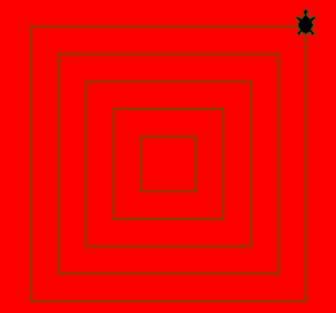
Create Your Own
We have only 1 aim in this lesson.
To use for loops in Turtle graphics to create a pattern of 5 concentric squares.
Notes:
The students will have a few tasks before attempting it. Once they complete the small tasks, they should get into groups/teams to Think Pair Share (TPSS) an algorithm to draw the concentric squares. This is the challenge on the last slide.

Slide 3
Create Your Own
We want to draw concentric squares, using a for loop
The sample code that follows uses a couple of new instructions such as penup() and pendown(), and creates 2 turtles, one in the shape of a turtle and one in the shape of a circle. Arthur then goes walkabout in a loop.
LO 2.2 students should be able to use a range of methods for identifying patterns and abstract common features
Notes:
The sample code for Arthur in the next slide does not use a loop. Some students may be comfortable changing Arthur’s code to a FOR loop directly.
The main Learning Outcomes (LO) achieved are highlighted throughout the lesson and tasks.
The list is not exhaustive, and consultation with the LCCS spec is encouraged at all times throughout the implementation of the course.

Slide 4
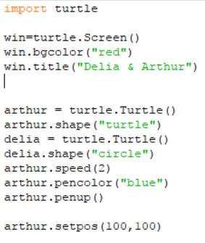
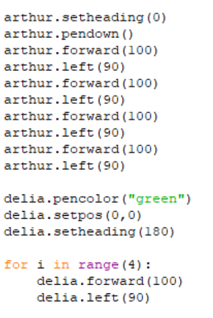
Sample Code
LO 1.3 students should be able to solve problems by deconstructing them into smaller units using a systematic approach in an iterative fashion
Notes:
Arthur deliberately written without using a loop. Some students may want to re-write his movements using a FOR loop.
Delia is hidden behind the box. She uses a FOR loop. The code is magnified on the next slide.

Slide 5
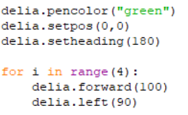
mini CHALLENGE
We want Delia to draw a square, like Arthur, but using a for loop.
It should only take a few lines of code. One way is given below.
LO 1.3 students should be able to solve problems by deconstructing them into smaller units using a systematic approach in an iterative fashion
Notes:
Some sample code for the basic for loop follows in the next slides

Slide 6
5 squares …. ThinkPairShareSquare
…. TPSS …Now think about an algorithm to draw 5 squares centred around the same point (concentric squares).
A for loop should be used to draw each square and a for loop to control the drawing of the 5 squares.
Check your algorithm with a partner, and develop your code.
NOTE
If you use a for loop to draw a square and place it within the main loop to draw 5 squares, you have a loop within a loop … called a NESTED loop.
LO 2.3 students should be able to implement modular design to develop hardware or software modules that perform a specific function
Notes:
Encourage students to write pseudo code in their algorithm…. They should be encouraged to construct basic NESTED loops

Slide 7
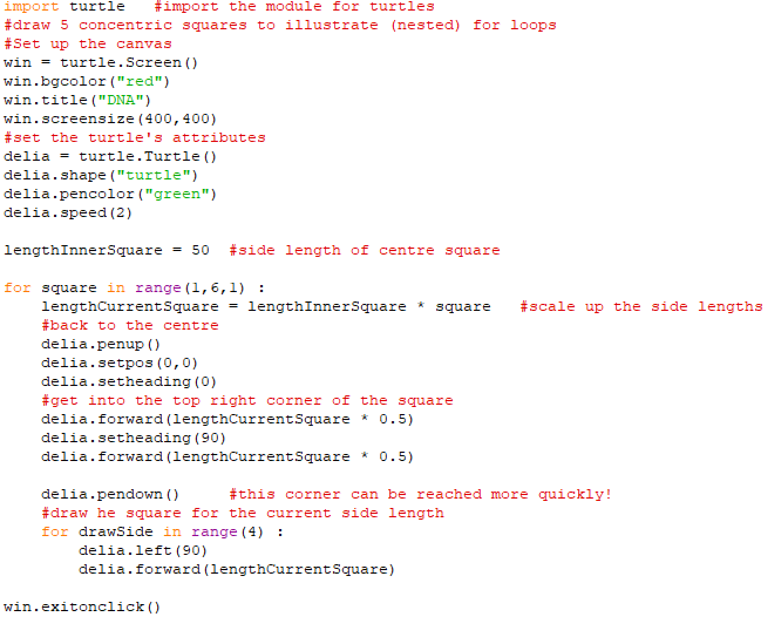
Sample Code (and #Comments)
WHY 0.5 ?
Notes:
Some Python code to draw 5 increasingly larger squares with the same centre (concentric). Delia goes to the centre each time and walks to her starting point.
The multiplication by 0.5 is because she starts in the centre. So travelling out to the right is only half a length, and then up to the top right hand corner is only half a length again.
There are quicker ways to get to the starting position each time. For example, on returning to the top right corner, go east 25 (lengthInnerSquare * 0.5) and north 25 to get to the next point. You could even bring in Pythagoras here, which could be useful for future collision detection in games.

Slide 8
CT Challenge… Turtle Simulation
A turtle (Edward) travels around a full circle.
He then travels at the same speed along some chords and radii in the circle.
Using a TURTLE simulation, you have to design a program to decide which route is the shorter route?
LO 1.9 students should be able to use modelling and simulation in relevant situations
LO 1.10 students should be able to discuss when heuristics should and could be used and explain the limitations of using heuristics (HL)
Notes:
The challenge is to use a form of turtle simulation to solve this problem.
The speed here is not a fully simulated speed, since it is really the speed with which the turtle graphics can draw a circle versus the straight lines of the chords and radii.
It is a CT challenge on the ncca website, aligned to the concepts and tasks in this section (and on a html platform)
Students should be encouraged to decompose the program and build up the functionality from working code.
Students must write the algorithm first. The CT Challenge will guide the students through the process.

