Slide 1
Learning to Program in Python
Concept 7
DEFINITIONS
(and a basic Database)
Notes:
Functions in Python are called Definitions. They are a KEY Threshold Concept in learning how to program.
The KEY question for this lesson should be : Why use functions at all?
The lesson should provide the answers: 1. Through the task and 2. Explicit reasons why functions are essential to efficient, readable code and CT skills

Slide 2
Students will asked to use definitions to create a simple database.
The program should be able to:
Read a txt file (database) with data on 4 famous people initially.
Store that data (in a dictionary or list).
Ask the user for data on another person.
Update the txt file (database)
Notes:
The Learning Intentions for this lesson are to read a simplified database and update the database.
The student can decide on their own data types for storage and must use definitions in their programs.

Slide 3
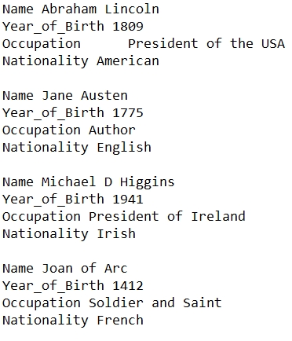
Write a program to read a Database
The data can be assumed to be stored in the txt file in this form.
LO 3.2 students should be able to create a basic relational database to store and retrieve a variety of forms of data types
Notes:
The txt file is stored in the same section as the task, on the ncca website.
The data on each person is assumed to be always in the form shown above.
Encourage students to use definitions, so their overall database management program can be built up in a modular fashion.

Slide 4
Write a program to read a Database
Write a definition to read in the data on each person.
Store that data in a way that is easily accessed, amended and added to.
LO 3.5 students should be able to structure and transform raw data to prepare it for analysis
Notes:
The txt file is stored in the same section as the task, on the ncca website.
The data on each person is assumed to be always in the form shown above.
Encourage students to use definitions, so their overall database management program can be built up in a modular fashion.

Slide 5
Once the data is read, think about a data type to store the data.
The program should be able to:
Read a txt file (database) with data on 4 famous people initially.
Store that data (in a dictionary or list).
Ask the user for data on another person.
Update the txt file (database)
LO 2.20 students should be able to identify and fix/debug warnings and errors in computer code and modify as required
Notes:
The Learning Intentions for this lesson are to read a simplified database and update the database.
The process of reading in the data, in the form of strings, leads naturally to storing the data in a desired format.
Dictionaries lend themselves very well to storing data due to its structure of keys and values.
A list structure would also work well, especially a 2D list, i.e each element of the list of people is a list of their data.

Slide 6
Use your data type to add on the data for the new famous person.
The program should be able to:
Read a txt file (database) with data on 4 famous people initially.
Store that data (in a dictionary or list).
Ask the user for data on another person.
Update the txt file (database)
LO 1.20 students should be able to collaborate and assign roles and responsibilities within a team to tackle a computing task
Notes:
The Learning Intentions for this lesson are to read a simplified database and update the database.
Dictionaries lend themselves very well to adding more data due to its structure of keys and values.
A list structure would also work well, especially a 2D list, i.e each new element of the list of people is a new list of their data.

Slide 7
Write out the new data to the txt file.
The program should be able to:
Read a txt file (database) with data on 4 famous people initially.
Store that data (in a dictionary or list).
Ask the user for data on another person.
Update the txt file (database)
Notes:
The Learning Intentions for this lesson are to read a simplified database and update the database.
Opening a text file in append mode, the new data can be easily appended, or all the stored data could used to overwrite the exiting txtfile.
Once the new updated file can be read again, the students will have created a basic working database management system.

Slide 8
Can your program do all of the following?
Did you use definitions to make your code both efficient and readable?
The program should be able to:
Read a txt file (database) with data on any number of famous people.
Store that data (in a dictionary or list).
Ask the user for data on another person.
Update the txt file (database)
LO 3.2 students should be able to create a basic relational database to store and retrieve a variety of forms of data types
Notes:
The Learning Intentions for this lesson are to read a simplified database and update the database.
The student can decide on their own data types for storage and must use definitions in their programs.

Slide 9
As an extra optional feature of your program, can you write a program to retrieve particular data for each person?
For example, a user may want only the names and occupations of all the famous people in the database.
Notes:
A DB management system should be able to retrieve specific information or update a character’s data.
Students may want the extra challenge of building this type of program, which also helps to address the LOs in strand 3, ALT1.

