Slide 1
Learning to Program in Python
Concept 5
LOOPS
(for loops)
Notes:
Students should know why a loop makes sense after the starter exercise, which follows.
The tasks and ideas would require several classes to ensure students have time to engage with the concept.
Loops are one of the key Threshold Concepts in learning how to program.
Later in the lesson, STRINGS are used. Subsequently there is an exercise on LISTS.
If LISTS haven’t been learned, just do the lesson to the point where LISTS enter, and make a decision how to proceed from that point.
The uses of LISTS only enters as a further challenge at the end.

Slide 2
A Starter Looping Challenge
We need to get 5 random numbers between 1 and 100.
You have been asked to write a program that asks 5 different users for their name and their random number (1-100).
You must also let the user know their place in the sequence. (i.e. whether they are inputting random number 1,2,3,4 or 5)
LO 1.5 students should be able to evaluate alternative solutions to computational problems
Notes:
STARTER EXERCISE This task is designed for students to write the code to ask one user, then replicate the code, with some minor adjustments, to ask the next user.
Encourage students to write an algorithm and pseudo-code. Guide students into writing an algorithm.
The idea is to create in the student the need for a better way to program this task – namely a need for a FOR loop.

Slide 3
A Looping Challenge
We need to get 5 random numbers between 1 and 100.
You have been asked to write a program that asks 5 different users for their name and their random number (1-100).
You must also let the user know their place in the sequence. (i.e. whether they are giving random number 1,2,3,4 or 5)
You can only use techniques learned so far. You have 10 minutes.
Save your program as : Five_Random_Numbers.py
Notes:
STARTER EXERCISE This task is designed for students to write the code to ask one user, then replicate the code, with some minor adjustments, to ask the next user.
Encourage students to write an algorithm and pseudo-code. Guide students into writing an algorithm.
The idea is to create in the student the need for a better way to program this task – namely a need for a FOR loop.

Slide 4
Sample Code ….
NOT Elegant Code
userName = input(‘What is your Name? ‘)
print(“Hello “, userName, “This is Random Number 1 of 5”)
userNumber1 = int(input(‘What is your Number between 1 and 100? ‘))
userName = input(‘What is your Name? ‘)
print(“Hello “, userName, “This is Random Number 2 of 5”)
userNumber2 = int(input(‘What is your Number between 1 and 100? ‘))
userName = input(‘What is your Name? ‘)
print(“Hello “, userName, “This is Random Number 3 of 5”)
userNumber3 = int(input(‘What is your Number between 1 and 100? ‘))
LO 1.5 students should be able to evaluate alternative solutions to computational problems
Notes:
The code students write will look something like the above.
Emphasise the repetition of code i.e. you could cut and paste each time in order to ask the next user, and then edit as necessary.
The main Learning Outcomes (LO) achieved are highlighted throughout the lesson and tasks.
The list is not exhaustive, and consultation with the LCCS spec is encouraged at all times throughout the implementation of the course.

Slide 5
NOT Elegant Code …. ThinkPairShareSquare
userName = input(‘What is your Name? ‘)
print(“Hello “, username, “This is Random Number 2 of 5”)
userNumber = int(input(‘What is your Number between 1 and 100? ‘))
…. TPSS …How many times did you copy and paste this kind of block of code in your program Five_Random_Numbers.py?
What if there were 500 random numbers required?
LO 2.21 students should be able to critically reflect on and identify limitations in completed code and suggest possible improvements
Notes:
Cutting, Pasting, Editing 500 times is not feasible. There must be a better way to solve a problem involving a task that has to be repeated.

Slide 6
NOT Elegant Code …. ThinkPairShareSquare
userName = input(‘What is your Name? ‘)
print(“Hello “, username, “This is Random Number 2 of 5”)
userNumber = int(input(‘What is your Number between 1 and 100? ‘))
…. TPSS …How many times did you copy and paste this block of code in your program Five_Random_Numbers.py?
There is a way to avoid having to copy and paste code.
Think about ways this might be done, or ways you have overcome this in other lanuages.
Then share it with a partner, and share with a group.
LO 1.23 students should be able reflect and communicate on the design and development process
Notes:
Important students Think Pair Share and Square this one.

Slide 7
Learning Intentions
From this lesson the students will:
Understand the concept of a loop
Write code to implement a for loop
Challenge themselves with using a for loop to input data from more than 1 user.
Notes:
Students may have been introduced to a WHILE loop before this.
The lesson (and CT challenge) will assume they have not seen loops before.
Loops are also called ITERATIONS.

Slide 8
The Concept : LOOPS
Loops are like running around a track.
You are performing the same task each time you complete a circuit – running around the track
The number of laps is increasing each time you complete a loop of the track.
Notes:
Students may have other analogies to add.

Slide 9
for loop
A for loop will continue to execute until all statements in a block (one lap of the running track) have been executed a certain number of times.
LO 1.7 students should be able to develop algorithms to implement chosen solutions
Notes:
This is the key difference to a while loop, which is a conditional loop, and therefore closely tied to if statements (decision-making, conditionals, selection statements)

Slide 10
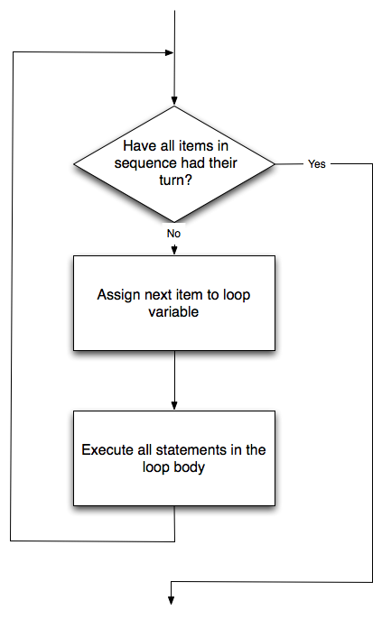
for loop Flow
Notes:
A FLOW chart representation

Slide 11
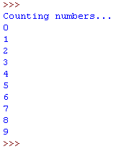
The for Loop in Python
Can you predict what the output will be ?
range(10) gives you a range of 10 numbers from 0 to 9.
Note: The value held in i automatically increases.
Try it on whatever IDE you are using.
Notes:
Important to ask students to predict an outcome before and as they type the code.
The PRIMM method will encourage engagement. (Predict Run Investigate Modify Make)

Slide 12
for loop
The previous example increased our variable by 1 and began at a value of 0.
What if we do not want to start at 0?
This for loop will start at 4 and end at 9.
LO 1.22 students should be able to read, write, test, and modify computer programs
Notes:
Ask students to predict before they write it into their IDE or IDLE

Slide 13
for loop in Python
(start value, ending value, amount to change)
The previous example:
began at a value of 4
increased by 1, to 10.
What if we do not want to increase by 1?
This for loop will start at 4 and end before 20, increasing by 2 each iteration.
Notes:
Ask students to predict before they write it into their IDE or IDLE.
The word iteration is intimately connected to the concept of loops.

Slide 14
Range
What range of values will the following execute?
range(10,20)
range(14, 18,3)
range(30, 15,-1)
range(5, -5, -1)
Notes:
Ask students to WRITE and PREDICT the results before they write it into their IDE or IDLE

Slide 15
Create Your Own
Write pseudocode and then a program in Python that :
creates a string called myString.
Uses a for loop to print each element in the string.
Remember :
LO 2.5 students should be able to use pseudo code to outline the functionality of an algorithm
Notes:
The students’ first for loop … but utilising strings. Encourage students to think of and write an algorithm in pseudocode to execute the task.

Slide 16
Create Your Own
Remember :
myString = “four for loops” creates a string called myString
len(myString) returns the length of the string
In this case len(myString)returns 14.
So how would range(len(myString))help you?
LO 2.16 students should be able to use data types that are common to procedural high-level languages
Notes:
The students’ first for loop … but utilising strings. Encourage students to think of and write an algorithm to execute the task.

Slide 17
CHALLENGE
Go back to Five_Random_Numbers.py
Now implement the program with a for loop.
Write an algorithm, using pseudo code
Implement the algorithm in code
Save your program as : Five_Random_Numbers v1.py
Notes:
Some pseudo code for the basic for loop follows in the next slide

Slide 18
for loop – asking 5 time
Think of an algorithm, in pseudo code, to ask for 5 numbers using a for loop.
For userNumber = 1 to 5 {
ask the user for their name;
print hello and their place in the sequence;
ask the user for a number from 1 to 100;
}
LO 2.5 students should be able to use pseudo code to outline the functionality of an algorithm
Notes:
Students thinking out the problem in advance, using paired programming and pen and paper, MUST be encouraged.
One of the limitations of this program is there is no means of storing the user info in a unique fashion so it can be recalled at a later stage.
The further challenge in the next slide addresses that problem using LISTS. This is worth discussing, since it gives a reason to enhance the program.

Slide 19
Optional extended CHALLENGE
You have implemented the program with a for loop.
further challenge … Enhance the program by :
using lists to store the information and
printing out to the user(s) the 5 numbers they chose
Notes:
LISTS are a concept covered in the next section. (See the ncca website). This challenge can thus be skipped over for now, and returned to later.
It is an option to do this challenge if lists have already been learned.
Some sample code follows in the next slide

Slide 20
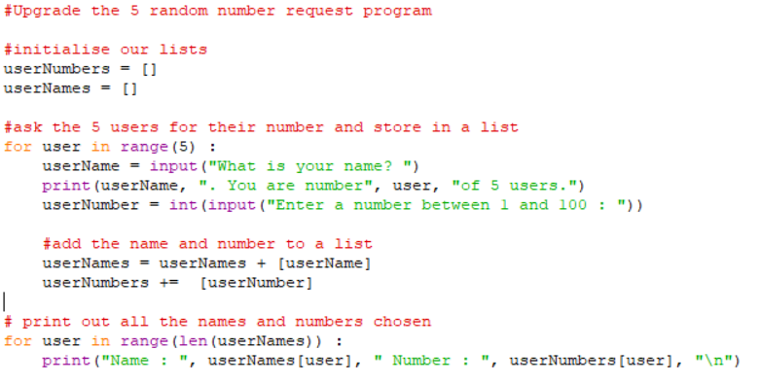
Sample Code
Notes:
Some code using a FOR loop to ask for 5 random numbers : Once students have written and tested their loops, some additional code needed to store the random numbers in a list and print out that list.
To challenge students who have completed, ask them how they could improve the program further, for example checking if the user enters a number between 1 and 100.

Slide 21
Lesson Review
As a result of this lesson I:
Understand the concept of a loop
Have written code to implement a for loop
Challenged myself with using a for loop to input data from more than 1 user.
Notes:
Some students may have already encountered loops in other languages or a WHILE loop in python.
The lesson does not assume they have.

