Slide 1
Learning to Program in Python
Concept 7
DEFINITIONS
(Recursive)
Notes:
Recursive definitions are only on the Higher Level course.
- The CT challenge requiring a recursive function, Paths and Nodes, is designated as HL. This requires Turtles to follow nodes on a graph to see if the path can be walked without repeating any nodes.
- The Die Hard Water Beakers CT Challenge is also designated HL, though this is more for the complexity of the problem and the UI, since recursive functions are not necessary to solve this particular challenge.

Slide 2
Learning Intentions
From this lesson the students will be able to:
Write a program that calls itself. A recursive function.
Define when a recursive function should be used.
Use a recursive function to find the factorial of any integer.
LO 2.9 students should be able to assemble existing algorithms or create new ones that use functions (including recursive), procedures, and modules
Notes:
Recursive functions are only on the HL course.

Slide 3
recall from FUNCTIONS
We can pass in as many parameters to a function as we like:
def fancyNumberOfInputs(a, b, c, x, y, z)
BUT we can only ever have one (if any) return from a function.
Notes:
A quick recap on how to write definitions, and define inputs and outputs.

Slide 4
Recall this definition
The command return sends back the variable to wherever the function was called.
(usually in the main program)
Notes:
What data type will be returned from the halveMe function?
It is a float because of the division by 2. The return command is essential to an understanding of the operation of recursive functions.

Slide 5
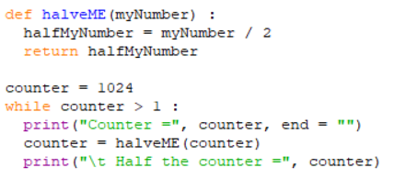
halveME in a LOOP
Beginning with 1024, predict the output of this program as it goes through each iteration of the loop.
LO 1.6 students should be able to explain the operation of a variety of algorithms
Notes:
The PRIMM method will encourage engagement. (Predict Run Investigate Modify Make)
Encourage students to use pen and paper to write the output from each successive iteration of the while loop.
There is a hint of the concept of recursion in this program, at the line : counter = halveME(counter).

Slide 6
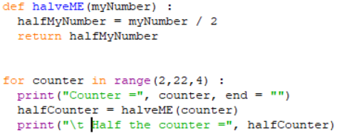
halveME in a LOOP
But what if the definition halveME called itself?
So instead of returning halfMyNumber we wrote :
halveME(halfMyNumber) ?
Notes:
A recursive definition is one that calls itself. Some of the questions are:
When does it ever return a value?
When does it stop calling itself?

Slide 7
Call Myself
Using pen and paper, predict the output.
Write the code and Let the output run.
You will (eventually) get an error telling you there are too many recursions.
How would you stop the program going below a value of 1?
Notes:
Try it out. In theory, the function should keep halving the starting number. Let the output run.
You will (eventually) get an error telling you there are too many recursions. What is the exact wording of the error?
PRIMM Encourage the students to attempt to include a terminating condition when myNumber goes below a value of 1.
(You can interrupt the program as it runs with ctrl-c)

Slide 8
CALL and STOP Myself
A recursive definition calls itself.
A terminating condition makes it stop calling itself at some point.
Notes:
The terminating condition here is to check if myNumber is at the value of 1. If it is 1, the definition returns a number and stops calling itself.
(The while loop could equally have been used here to control the terminating condition.)
PRIMM Encourage the students to attempt to modify the terminating condition when myNumber goes below a value of say 0.01?
(You can interrupt the program as it runs with ctrl-c)

Slide 9
A Basic Recursive Function
A recursive function can often be used when:
A problem can be broken down into an identical, just smaller, problem. (A sub-problem)
There is a definite terminating condition. In other words as the sub-problems get smaller, there is eventually a definite answer. The sub-problem cannot be broken down any further. Also called a Base Case.
LO 2.9 students should be able to assemble existing algorithms or create new ones that use functions (including recursive), procedures, and modules
Notes:
Recursive Functions are only on the HL section of the course.

Slide 10
A Basic Recursive Function
Investigate the program on the next slide.
Can you see the 2 characteristics of a problem solved using recursion?
LO 1.3 students should be able to solve problems by deconstructing them into smaller units using a systematic approach in an iterative fashion
Notes:
Students should be looking out for decomposition and a terminating (or stopping) condition.

Slide 11
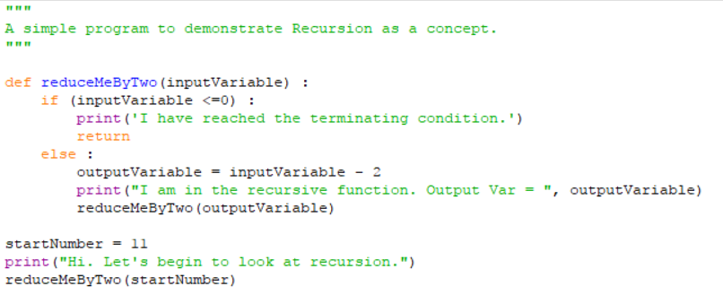
Sample Code
Problem -> Sub-Problem ?
Terminating Condition ?
Notes:
The PRIMM method will encourage engagement. (Predict Run Investigate Modify Make)

Slide 12
The FACTORIAL of an integer!
The factorial of 3 is 3 x 2 x 1.
The factorial of 6 is 6 x 5 x 4 x 3 x 2 x 1.
The symbol for factorial n is n!
3! = 6. 6! = 720. n! = nx(n-1)x(n-2)….3x2x1
LO 2.5 students should be able to use pseudo code to outline the functionality of an algorithm
Notes:
The PRIMM method will encourage engagement. (Predict Run Investigate Modify Make)
Encourage students to use pseudocode to solve this problem, both non-recursively and recursively.

Slide 13
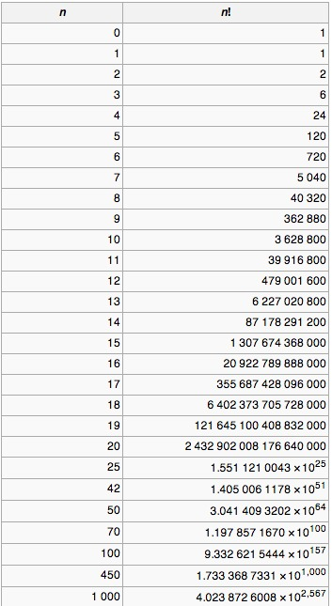
CHALLENGE
Write a program that
Calculates the factorial of a number without using a recursive definition.
Then write a program using a recursive definition.
LO 2.5 students should be able to use pseudo code to outline the functionality of an algorithm
Notes:
Encourage students to tackle the problem with both solutions :
LO 1.2 students should be able to explain how the power of computing enables different solutions to difficult problems.
Also, encourage a program in pseudocode first before programming the solution in Python.

Slide 14
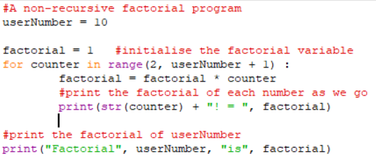
Sample Factorial Program non-recursive
LO 1.2 students should be able to explain how the power of computing enables different solutions to difficult problems
Notes:
This is merely suggestive of code to calculate and print the factorial of a number.
Encourage students to modify their programs, including this sample code.

Slide 15
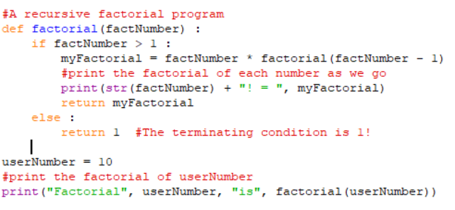
Sample Factorial Program recursive
LO 1.2 students should be able to explain how the power of computing enables different solutions to difficult problems
Notes:
This is merely suggestive of code to calculate and print the factorial of a number.
Encourage students to modify their programs, including this sample code.

Slide 16
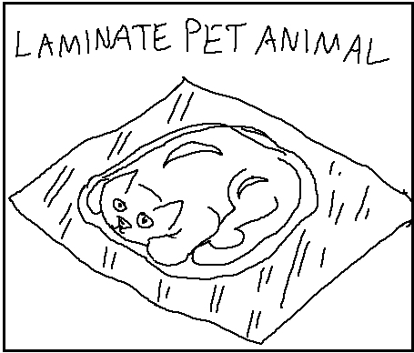
CHALLENGE
Write a function that
Takes a word (string) from the user.
Checks if the word is a Palindrome, non-recursively
Does this recursively!
RACECAR
goes forwards and backwards
LO 2.20 students should be able to identify and fix/debug warnings and errors in computer code and modify as required
Notes:
There is much be gained from students executing this task both recursively and non-recursively.
A cool way to reverse a string or list is : revPhrase = userPhrase[ : : -1] …… let the students figure out their own ways first.

Slide 17
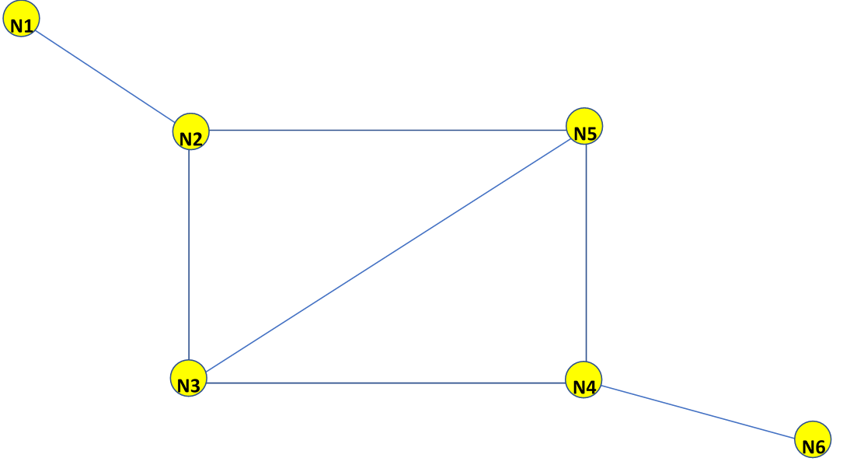
CT Challenge… Paths and Nodes
Your task is to use a recursive function to figure out how to cross the graph, from node1 (N1) to node6 (N6).
As the Turtles follow the nodes on the graph, the challenge is to find paths that can be walked without repeating any nodes.
Notes:
This is a difficult CT challenge on the ncca website, aligned to the concepts and tasks in this section (and on a html platform)
Students should be encouraged to decompose the program and build up the functionality from working code.
Students must write the algorithm first. The CT Challenge folder (html file) will guide the students through the process.
The Recursive definitions are only on the Higher Level course.
- The CT challenge requiring a recursive function, Paths and Nodes, is designated as HL. This requires Turtles to follow nodes on a graph to see if the path can be walked without repeating any nodes.
- The Die Hard Water Beakers CT Challenge is also designated HL, though this is more for the complexity of the problem and the UI, since recursive functions are not necessary to solve this particular challenge.

Slide 18
Lesson Review
As a result of this lesson:
I can write a program that calls itself. A recursive function.
I can define when a recursive function should be used.
I have written recursive definitions for a variety of different problems and contexts.
LO 1.5 students should be able to evaluate alternative solutions to computational problems
Notes:
Recursive functions are HL material.

