Slide 1
Learning to Program in Python
Concept 7
FUNCTIONS
(Definitions)
Notes:
Functions in Python are called Definitions. (Functions across other languages are called methods, procedures, and so forth)
They are a KEY Threshold Concept in learning how to program.
The KEY question for this lesson should be : Why use functions at all?
The lesson should provide the answers: 1. Through the task and 2. Explicit reasons why functions are essential to efficient, readable code and CT skills

Slide 2
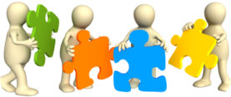
Learning Intentions
From this lesson the students will be able to:
Understand why functions enhance a program.
Write their own definitions. (functions)
Notes:
Students need to be comfortable creating basic functions to carry out even the most seemingly trivial tasks.
For development of future algorithms and to participate in the Unit Testing module, they need to develop a proficiency with functions in these lessons.
Why use functions is equally as important as how to use them!!!

Slide 3
Functions are OLD NEWS
INPUT, INT, and PRINT are examples of functions in programming.
We call them and they go off and carry out lots of instructions.
LO 2.9 students should be able to assemble existing algorithms or create new ones that use functions (including recursive), procedures, and modules
Notes:
Students have been using functions (definitions) already, but may not have realised it.
3 functions are named above (INPUT, INT, PRINT). Can students name some other built-in definitions in Python?

Slide 4
Functions are OLD NEWS
INPUT, INT, and PRINT are examples of functions in programming.
We don’t see what they do inside the function but they carry out what we want them to do (printing, casting, etc..)
Notes:
Students have been using functions (definitions) already, but may not have realised it.
3 functions are named above (INPUT, INT, PRINT). Can students name some other built-in definitions in Python?

Slide 5
A simple 5 step algorithm
Examine the algorithm below.
What would you say are its characteristics?
Ask the user for a number
Ask the user for another number
Add the two numbers
Multiply the two numbers
Print out the result of both operations
LO 2.2 students should be able to use a range of methods for identifying patterns and abstract common features
Notes:
You are looking for answers along the lines of readability, re-usability, reduction to smaller blocks of tasks (modules or modularity),
flow control, packaging up of tasks, abstraction , etc…..
Why we use functions will be outlined later, after students have used and written some definitions.

Slide 6
Easy to Code
We could easily write code for each line.
For example :
Ask the user for a number
Add the two numbers
Print out the result of both operations.
Notes:
You are looking for readability, re-usability, reduction to smaller blocks of tasks (modules or modularity), flow control, packaging up of tasks, abstraction , etc…..
Why we use functions will be outlined later, after students have used and written some definitions.

Slide 7
A simple 5 step algorithm
But let’s write our own functions (called definitions in Python) to carry out the 5 simple steps in our algorithm.
Ask the user for a number
Ask the user for another number
Add the two numbers
Multiply the two numbers
Print out the result of both operations
LO 2.3 students should be able to implement modular design to develop hardware or software modules that perform a specific function
Notes:
You are looking for readability, re-usability, reduction to smaller blocks of tasks (modules or modularity), flow control, packaging up of tasks, abstraction , etc…..
Why we use functions will be outlined later, after students have used and written some definitions.

Slide 8
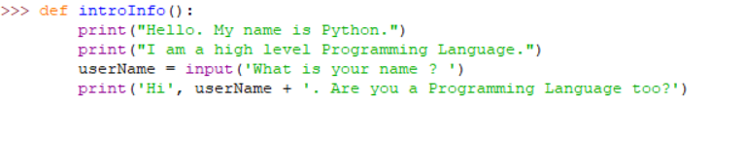
First : How to write a Definition
The definition above is called introInfo.
The heading contains def, the name of the function, brackets, and finally a colon. The statements inside a function are indented.
The general syntax is
def name_of_your_function():
Notes:
Encourage the students to go to their IDE and experiment with this definition.

Slide 9
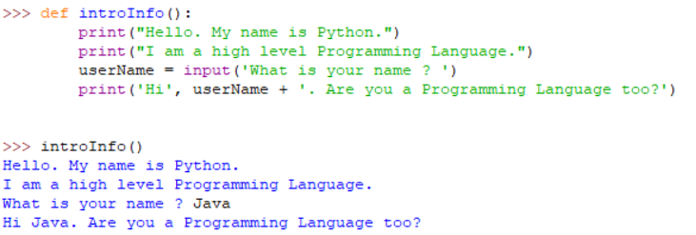
Second : How to Call a Definition
Go to your IDE and type in an introInfo() definition.
Note how the brackets are needed to call it.
Notes:
Encourage mistakes and deliberate syntax errors such as omitting the brackets when calling a definition or leaving out the colon (:) in the definition.

Slide 10
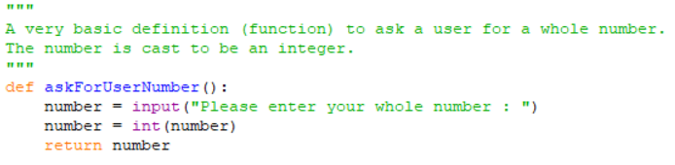
A definition for the 1st step
Let’s write our own definition to carry out the 1st step in our algorithm.
Ask the user for a number
Notes:
Ask the students to PREDICT what they think this definition will do, and in particular, what the return statement means.
The PRIMM method will encourage engagement. (Predict Run Investigate Modify Make)
(It is discussed in the next slide.)
What are the potential UI problems students can foresee with this code?

Slide 11
A simple algorithm
When the definition is called, it will send back, or return, the value in the variable called number.
So for example, x = askForUserNumber()
will store the user’s number in a variable called x.
Notes:
You are looking for readability, re-usability, reduction to smaller blocks of tasks (modules or modularity), flow control, packaging up of tasks, abstraction , etc…..
Why we use functions will be outlined later, after students have used and written some definitions.

Slide 12

A definition for the 2nd step
The definition for the second step of the algorithm is identical to the first step.
Ask the user for a number
LO 2.2 students should be able to use a range of methods for identifying patterns and abstract common features
Notes:
Ask the students to explain this line of code. The RE-USABILITY and ABSTRACTION features of a functions is clearly seen in this 2nd step of the algorithm.

Slide 13
Definitions can take inputs also
INPUT(), INT(), and PRINT() are examples of definitions in Python.
To use the INT() definition, you have to provide it with an input.
For example, INT(3.5) takes 3.5 as its input and casts it to an integer value.
Notes:
Students have been using functions (definitions) already, but may not have realised it.
The 3 definitions in this example all take some form of input in their brackets.
So print(“Definitions are really useful and re-usable”), takes a string as its input and prints it out to the end user.

Slide 14
Definitions can take inputs also
INPUT(), INT(), and PRINT() are examples of definitions in Python.
Likewise PRINT() must have some input inside its brackets, as shown in the example above.
Notes:
Students have been using functions (definitions) already, but may not have realised it.
The 3 definitions in this example all take some form of input in their brackets.
So print(“Definitions are really useful and re-usable”), takes a string as its input and prints it out to the end user.

Slide 15
A definition for the 3rd and 4th steps
Let’s write our own definition in PSEUDOCODE to carry out the 3rd and 4th steps in our algorithm, and we will use an input to the definition.
Add the two numbers
Multiply the two numbers
LO 2.5 students should be able to use pseudo code to outline the functionality of an algorithm
Notes:
The PRIMM method will encourage engagement. (Predict Run Investigate Modify Make)
Ask the students to write in PSEUDOCODE, a definition that can handle addition OR multiplication depending on what the user requests.
(It is discussed in the next slide.)

Slide 16
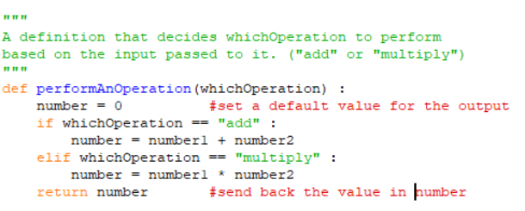
A definition for the 3rd and 4th steps
Add the two numbers
Multiply the two numbers
Notes:
Ask the students to PREDICT what they think this definition will do, and in particular, how the conditional statement is working.
(It is brought together in the next slide.)
Can they see potential UI problems with the code above?

Slide 17

Calling the first 4 definitions
Steps 1 to 4 of our algorithm now look like this in Python.
Our definitions are re-used and can be continually re-used.
LO 2.9 students should be able to assemble existing algorithms or create new ones that use functions (including recursive), procedures, and modules
Notes:
The algorithm is now in a very abstracted and modular form. It is also very readable as code.
The final step will be left to the students to perform.

Slide 18
RECAP on FUNCTIONS
LO 2.3 & 2.9
Functions are a useful way to
divide your code into blocks of tasks
order our code
make programs more readable
re-use blocks of code
implement a modular design (i.e. using modules of code to carry out tasks).
In Python, modules and definitions are a key way to define interfaces so programmers can share their code. We will see this in the tasks and exercises in the Unit Testing lesson.
Notes:
Functions very specifically address LO 2.3 and 2.9 in the LCCS specification.
2.3 students should be able to implement modular design to develop hardware or software modules that perform a specific function
2.9 students should be able to assemble existing algorithms or create new ones that use functions (including recursive), procedures, and modules
The 5th step in the simple algorithm will be left to the students as a task.

Slide 19
A definition for the 5th step
OVER TO YOU.
Complete the full algorithm executed in Python.
Ask the user for a number
Ask the user for another number
Add the two numbers
Multiply the two numbers
Print out the result of both operations
Notes:
Building on the 4 steps students have designed, encourage pair programming to complete a fully implemented Python program to execute the simple 5 step algorithm.

Slide 20
Learning Review
From this lesson I am able to:
Understand why functions enhance a program.
Write my own definitions. (functions)
Notes:
Functions in Python are called Definitions.
The KEY relfection question for this lesson should be : Why use functions at all?
The lesson should provide the answers: 1. Through the tasks and 2. Explicit reasons why functions are essential to efficient, readable code and CT skills

