Slide 1
Learning to Program in Python
Concept 2
Basic Inputs and Outputs
Notes:
A revision of input and print. Plus a look at how to create a new txt file, and read, write and close txt files.
The tasks and ideas would require several classes to ensure students have time to engage with the concept.

Slide 2

Learning Intentions
From this lesson the students will be able to:
  Send and receive data
  Create a new txt file
  Read, write and modify txt files
Notes:
The tasks in this lesson should be carried out by the students. Ensure that chosen IDEs can handle file access and file storage.
The main Learning Outcomes (LO) achieved are highlighted throughout the lesson and tasks.
The list is not exhaustive, and consultation with the LCCS spec is encouraged at all times throughout the implementation of the course.

Slide 3
A first program from the starter lesson
1. Ask the user of your program for their age.
2. Add 100 to their age.
3. Print out their age in 100 years.
LO 1.22 students should be able to read, write, test, and modify computer programs
Notes:
A very first program / algorithm to perform a very simple task.
The basic tools of receiving data (input()) and sending data (print()) have already been used.

Slide 4
INPUT - Receiving Data
1. Ask the user of your program for their age.
The input() command asks the user for data.
To retain and use the user data, it is stored in a variable.
The data from the user is in the format of a string (i.e text)
1.15 consider the quality of the user experience when interacting with computers and …
Notes:
Revision of the input() command for obtaining data from the (end) user.

Slide 5
OUTPUT - Sending Data
3. Print out their age in 100 years.
The print() command sends data to the user (through the standard output).
The data from the print() command is in the format of a string (i.e text)
Notes:
Revision of the print() command for sending data to the stdout or standard output of the IDE being used,

Slide 6


What if you want to use a file, and not the user, to input and output data?
LO 1.16 students should be able to compare two different user interfaces and identify different design decisions that shape the user experience
This Photo by Unknown Author is licensed under CC BY-SA
Notes:
Print() sends information to the stdout and input() receives data from the user.
What mechanism and commands will enable data to be sent and received through a txt file?

Slide 7
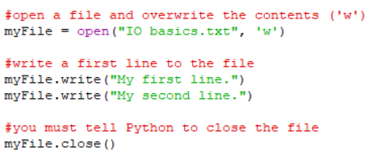
Create a txt file and write some text to the file
Try out this program.
Save it for future use.
Notes:
A very first program to create a txt file (IO basics.txt). Encourage students to write this program in their IDE and save the program.
Once again, remind students that the hash (#) symbol tells Python to ignore what follows, and are thus comments to help the user understand the code.
The Open command is in the ‘w’ mode which is write mode. All text previously there will be overwritten. Essentially new content is being inserted.

Slide 8
Create a txt file and write some text to the file
IO basics.txt file
My first line.My second line.
Open your txt file.
What do you notice?
Notes:
A very first program to create a txt file (IO basics.txt). The IO basics,txt file will display only one line of text.
This is to emphasis that you must include the newline character (\n) in the string that you send to the txt file.
See code on next slide.

Slide 9
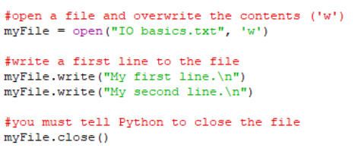
Inserting on a new line
IO basics.txt file
My first line.
My second line.
“\n” inserts a new line in the output.
Find out what the backslash (“\”) is called.
Notes:
A very first program to create a txt file (IO basics.txt). The IO basics,txt file will now display two lines of text.
This is to emphasis that you must include the newline character (\n) in the string that you send to the txt file.
The backslash (“\”) is an escape character in Python. Two very common ones are “\n” for a newline, and “\t” for a tab.

Slide 10
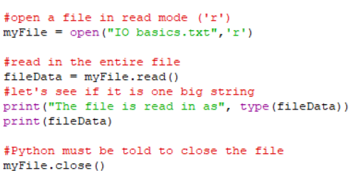
Read a txt file
Try out this program.
Save it for future use.
LO 2.18 students should be able to collect, store and sort both continuous and discrete data
Notes:
A very first program to read a txt file (IO basics.txt). Encourage students to write this program in their IDE and save the program.
Once again, remind students that the hash (#) symbol tells Python to ignore what follows, and are thus comments to help the user understand the code.
The Open command is in the ‘r’ mode which is read mode. All data from the file is in the form of strings (or text).

Slide 11

Output from previous code
Class ‘str’ refers to
fileData being a string
Notes:
A very first program to read a txt file (IO basics.txt). Encourage students to write this program in their IDE and save the program.
Once again, remind students that the hash (#) symbol tells Python to ignore what follows, and are thus comments to help the user understand the code.
The Open command is in the ‘r’ mode which is read mode. All data from the file is in the form of strings (or text).

Slide 12
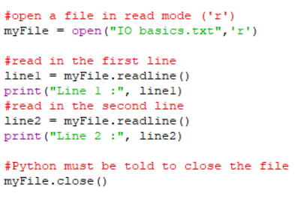
Read a txt file – line by line
Examine the output
from the print() statements
Notes:
A program to read a txt file (IO basics.txt) line by line. Encourage students to write this program in their IDE and save the program.
Once again, remind students that the hash (#) symbol tells Python to ignore what follows, and are thus comments to help the user understand the code.
line1 and line2 are string representations of each line. All data from the file is in the form of strings (or text).

Slide 13
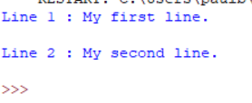
Output from reading a txt file
Notice there seems to be an extra newline (\n) after each output. Why?
Notes:
A program to read a txt file (IO basics.txt). Encourage students to write this program in their IDE and save the program.
The extra \n is within the line of data read from the file, in addition to the \n built in to the print statement.
To override the \n in the line of data either write : line1 = myFile.readline().replace(“\n”,””) OR print (“Line 1 :”, line1, end=“”).
The Open command is in the ‘r’ mode which is read mode. All data from the file is in the form of strings (or text).

Slide 14



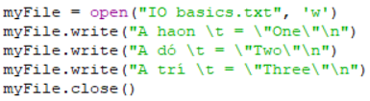
Predict code to achieve the File Content indicated
- Test out your code in your IDE to verify -
File Content | Suggested Code
A haon
A haon A dó
A haon = “One” A dó = “Two” A trí = “Three”
Hint : myFile = open(“Test File.txt”, ‘w’)
Notes:
The word descriptions of the operations are important. (Slice, Assign, Append etc….)
Encourage students to predict the outcomes. The PRIMM method will encourage engagement. (Predict Run Investigate Modify Make)
The assignment and concat are useful for the solution to the next challenge.

Slide 15
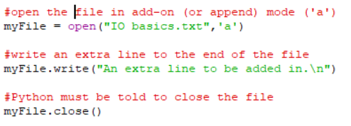
Add on to an existing txt file
Examine the txt file.
How do you think you would insert
a line at the start of the txt file?
LO 1.2 students should be able to explain how the power of computing enables different solutions to difficult problems
Notes:
A program to append to a txt file (IO basics.txt). Encourage students to write this program in their IDE and save the program.
https://docs.python.org/3/tutorial/inputoutput.html gives a comprehensive overview of what you can do in Python with txt files.
The next slide has optional program to add a new line at the start is on the slide. Students have to figure out what is going on. It is only optional whether the next slide is covered.

Slide 16
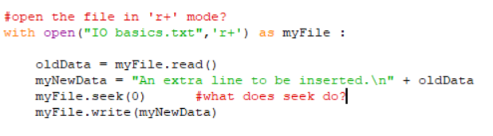
Mystery File Editing
Using Think Pair Share and a browser,
can you figure out what this program does?
Notes:
This is OPTIONAL : Encourage students to think alone first, but using a browser or cheat sheet, and then pair with their partner and share with a wider group.
Encourage them to read, test and experiment with the code before coming to any conclusions.

Slide 17
We used the variable myFile a lot.
myFile is known as a file object.
You can use all sorts of methods on a file object, such as open and close, read and write, readlines and writelines, seek, etc.
https://docs.python.org/3/tutorial/inputoutput.html#reading-and-writing-files
Notes:
Check out the cheat sheets online or on the ncca website.

Slide 18
Learning Review
From this lesson I am able to:
  Send and receive data
  Create a new txt file
  Read, write and modify txt files
Notes:
The main Learning Outcomes (LO) achieved are highlighted throughout the lesson and tasks.
The list is not exhaustive, and consultation with the LCCS spec is encouraged at all times throughout the implementation of the course.

