Slide 1
Learning to Program in Python
Concept 2
Basic IO - Turtle Graphics
Notes:
How to control basic motion using Turtle graphics; plus a passing intro to import/attributes/objects.
The main Learning Outcomes (LO) achieved are highlighted throughout the lesson and tasks.
The list is not exhaustive, and consultation with the LCCS spec is encouraged at all times throughout the implementation of the course.

Slide 2
Learning Intentions
From this lesson the students will be able to:
Create 2 or more instances of a turtle
Make turtles draw patterns
Understand terms such as Module, Import, Class, Object, Attributes.
Notes:
These are the explicit aims… however the Turtle library allows the introduction the concept of IMPORT, MODULE, VARAIBLES and ATTRIBUTES without any full explanation needed at this early point

Slide 3
The turtle MODULE
Python allows you to import extra modules, specifically written for Python users.
One of them is called turtle. You must import it to use it. You can then open a graphics window.
import turtle # so we can use the turtles library of commands
win = turtle.Screen()
# creates a graphics window
LO 2.9 students should be able to assemble existing algorithms or create new ones that use functions (including recursive), procedures, and modules
Notes:
The turtle. prefix is needed when you just use import turtle. If you used from turtle import * you could dispense with the turtle. prefix.

Slide 4
The Turtle CLASS
A Turtle is an example of class. ( turtle.Turtle())
When you create a new turtle it is called an INSTANCE. You can also call it an OBJECT.
import turtle
win = turtle.Screen()
#make an instance of a turtle and we will call it delia
delia = turtle.Turtle()
Notes:
Class is not part of the LCCS spec, however students will encounter classes in the course of their learning.

Slide 5
Turtle attributes
Now you have an object called delia, you can give the turtle unique characteristics or ATTRIBUTES like shape and speed.
The list of attributes you give to the Turtle will make delia a unique turtle.
LO 1.9 students should be able to use modelling and simulation in relevant situations
Notes:
Data representation is an essential component of Computational Thinking. Variables with attributes allow for greater programming control and complexity.
The CT level of a program in Scratch can be analysed using the DrScratch html resource on ncca.ie. Text-based and Block-based programming can complement each other.

Slide 6
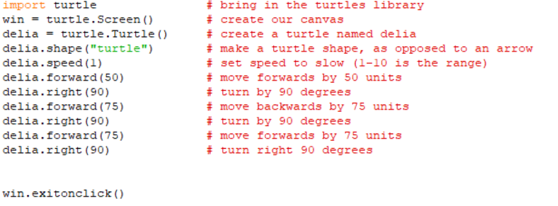
Example
Predict the shape that the Turtle delia will draw following the algorithm below.
Notes:
The PRIMM method will encourage engagement. (Predict Run Investigate Modify Make)

Slide 7
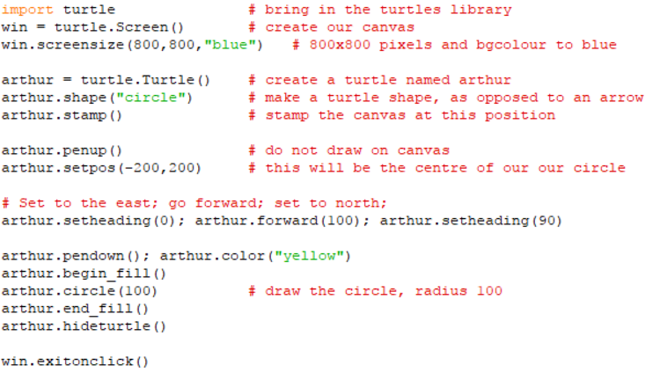
Examples of some more attributes and instructions
Notes:
Highlight the circle method, as this will be needed for the computational challenge involving a simulation of a circle and chords as part of learning loops.

Slide 8
Class Task
Create two instances of a turtle.
Call them delia and arthur.
delia is to go to position (50,50) and draw a square with that as centre. She then has to go to these 3 points, without leaving a trail, and stamp the 3 points …(-30,30), (100,-50), (0,0)
arthur is to draw two circles. One of radius 50 centre(0,0) and another of radius 40 centre (100,-50). Also the circles are to be filled with colours.
https://docs.python.org/3/library/turtle.html
LO 2.20 students should be able to identify and fix/debug warnings and errors in computer code and modify as required
Notes:
A full description of the turtle library is at https://docs.python.org/3/library/turtle.html. (Or just google appropriately)

Slide 9
Challenge
Ask the user for the coordinates of the centre of a circle, a radius and a fill colour.
Get these properties for both delia and arthur and instruct them to draw the circles.
Finish with a stamp on the centre.
Write on each circle the properties given by the user.
For example “This is a red circle, centre (30,-30) and radius 45.”
https://docs.python.org/3/library/turtle.html
LO 1.7 students should be able to develop algorithms to implement chosen solutions
Notes:
A full description of the turtle library is at https://docs.python.org/3/library/turtle.html. (Or just google appropriately)

Slide 10
Lesson Review
From this lesson I am able to:
Create 2 or more instances of a turtle
Make turtles draw patterns
Understand terms such as Module, Import, Class, Object, Attributes.
Notes:
On the NCCA website the challenge to decide whether the length of the circumference is longer than the length of some chords and radii in the circle would use a lot of the code in this lesson to simulate the problem.
The main Learning Outcomes (LO) achieved are highlighted throughout the lesson and tasks.
The list is not exhaustive, and consultation with the LCCS spec is encouraged at all times throughout the implementation of the course.

