Slide 1
Learning to Program in Python
Concept 6
DICTIONARIES
(and Lists)
Notes:
Dictionaries are a form of data structure. They have a key and a value you can look up with that key.
Like Lists, they are a form of arrays, but they are not ordered the way Lists are. Also the keys and values allow you to look up information.
In this way they resemble LOOKUP tables or caches. 2D Lists are an alternative to dictionaries as a form of advanced data structure.
The tasks and ideas would require several classes to ensure students have time to engage with the concept.

Slide 2
Learning Intentions
From this lesson the students will be able to:
Understand the concept and use of a dictionary
Look up KEYS and VALUES in a dictionary
Create, Add and Delete items from a dictionary
Read from a file and store data in a dictionary
Analyse strings of data
Notes:
Students will be testing out simple dictionary methods and properties during the lesson, and reading files.
The main Learning Outcomes (LO) achieved are highlighted throughout the lesson and tasks.
The list is not exhaustive, and consultation with the LCCS spec is encouraged at all times throughout the implementation of the course.

Slide 3
DICTIONARIES
classRole above is a dictionary.
Note the use of curly brackets {} to create the dictionary.
LO 2.16 students should be able to use data types that are common to procedural high-level languages
Notes:
The dict() method can also create a dictionary.

Slide 4
Add a new item
Each person above is called a KEY
Each class name above is called a VALUE
The KEY and VALUE are called an ITEM
Notes:
Students should be encouraged to add new items to this dictionary.

Slide 5
Why Dictionaries?
We have used LISTS to store and modify information.
DICTIONARIES allow us to do that but we also have a record of our information that we can easily look up, update and sort.
Notes:
Dictionaries allow us create objects. The key element of the lesson from this point is to emphasise the added power and usability that dictionaries can offer.

Slide 6
Why Dictionaries?
If you are asking a user for specific information, like Name, DOB, etc. then these become your KEYS.
Their data becomes the VALUES.
Notes:
Dictionaries allow us create objects. The key element of the lesson from this point is to emphasise the added power and usability that dictionaries can offer.

Slide 7
Why Dictionaries?
Any general characteristics (name, volume, &c) that map on to specific information (Eamonn, 20 litres, &c) can be stored in dictionaries.
Notes:
Dictionaries allow us create objects. The key element of the lesson from this point is to emphasise the added power and usability that dictionaries can offer.

Slide 8
Why Dictionaries?
DICTIONARIES are really good at representing things or objects. The CT challenge on Caesar Shift encryption suggests using dictionaries.
See also the Treasure Chests CT Challenge.
Notes:
Dictionaries allow us create objects. The key element of the lesson from this point is to emphasise the added power and usability that dictionaries can offer.
The Caesar Shift challenge lends itself to the use of dictionaries to help automate a solution to the problem.

Slide 9
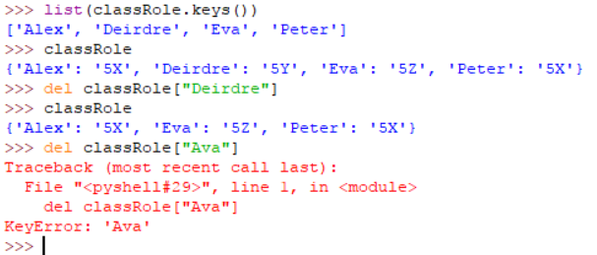
Delete an item
Look carefully at each line of code.
Why is there an error on the last line?
LO 1.22 students should be able to read, write, test, and modify computer programs
Notes:
The error is because “Ava” is not a key. It is “Eva”.

Slide 10
Change a VALUE
It is very easy to change a value.
Note that newClassRole = {} will create a new empty dictionary.
Notes:
Students will need to be able to do this for the challenges in the next couple of slides.

Slide 11
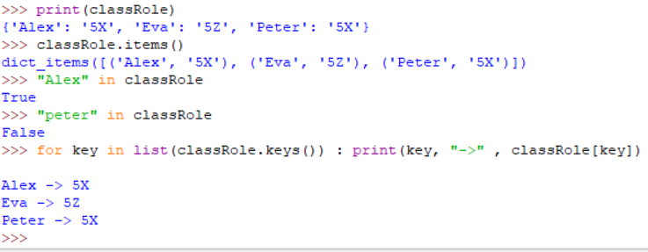
Looping through Items
Look carefully at each line of code.
Explain what the for loop is doing.
Notes:
Note that the items in a dictionary are stored as pairs or items.
Draw attention to the loop which captures the keys and values of each entry in the dictionary.
An alternative way to code this is :
for key in classRole : print(key, “->”,classRole[key])

Slide 12
Fill in the outcome or updated solution to each question
- can you predict the value in each case ? -
oscarWinner = { "Leo" :2016, "Kate" :2009, "Saoirse" :2018 }
Q | Based on the oscarWinner(s) …. | Outcome/Solution
0 | oscarWinner[“Leo”] | 2016
1 | oscarWinner[“Saoirse”] = oscarWinner[“Saoirse”] +3 | 2021
2 | list(oscarWinner.values()) | [2016, 2009, 2021]
3 | print(“Katie” in oscarWinner) | False
4 | How would you create the list: [“Leo”, “Kate”, “Saoirse”] | list(oscarWinner.keys())
5 | for actor in oscarWinner : print(actor, “-”, oscarWinner[actor]) | Leo – 2016 Kate – 2009 Saoirse - 2021
Notes:
The worksheet above can be downloaded from the ncca website (dictionaries), completed by the students and stored in their online space.
Or it can be printed out for a written class task. The PRIMM method will encourage engagement. (Predict Run Investigate Modify Make)
The answers are revealed when the slide show is run.

Slide 13
An Example
Let’s say we have a string “dictionaries and lists”
We need to calculate how many times each letter appears in the string.
The information for each letter must be stored, easily accessed and also printed out.
Using ThinkPairShare, design an algorithm and pseudo code to solve this problem.
LO 3.7 students should be able to use algorithms to analyse and interpret data in a way that informs decision-making
Notes:
Encourage students, in pairs, to brainstorm (coggle might help here) on the algorithm and flow of their program, before writing any code.
If using Cheat Sheets, encourage students to use them.
One of the NCCA examples for ALT2 (Analytics) analyses the words in a txt file in a similar fashion.

Slide 14
Be Resourceful
As usual, to see what you can do in Python, consult your Cheat Sheet or just go to some of the recommended sites for writing Python….
docs.python.org
Runestone Academy
tutorialspoint.com
LO 2.6 students should be able to construct algorithms using appropriate sequences, selections/conditionals, loops and operators to solve a range of problems, to fulfil a specific requirement
Notes:
Students need to be able to find lots of their own answers. 3B4ME … Brain, Browser, Buddies before the Boss
This design is a vary basic form of ALT2 – Data Analytics. The main dictionary challenge that follows later for this concept is a more difficult analytics challenge.

Slide 15
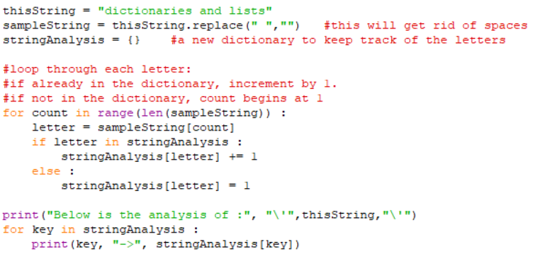
Sample Code for Example
Notes:
The sample code strips out white spaces. This is optional. Also, the first for loop, could be made more concise by using : for letter in sampleString :
Students could be asked how to enhance their program, for example to ask the user for a string to analyse or use the plotly library to draw a bar chart of the analysis.
Also, in the lesson on tasks involving functions, one of the tasks returns to this program.

Slide 16
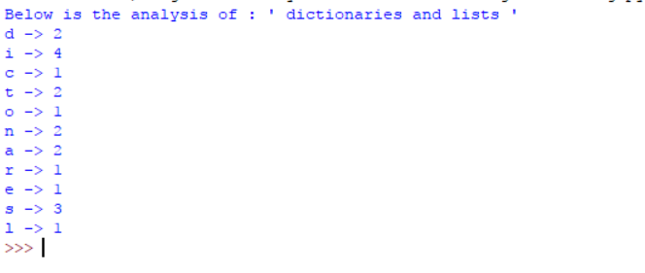
Output from Sample Code
LO 2.21 students should be able to critically reflect on and identify limitations in completed code and suggest possible improvements (HL)
Notes:
What the previous slide’s sample code will output.
Could it be improved? Can the students assess their own outputs and identify improvements to the logic and to the UI? Perhaps include a graphical output using the plotly library.

Slide 17
DICTIONARY CHALLENGE
Write a program that:
Reads a file that has lines of names in it, that repeat regularly.
Counts how many times each name appears in the file.
Stores the analysis in a dictionary.
Prints out the info in a readable format.
Philippa
Sean
Ciara
Mahmoud
Sean
Philippa
Ciara
Robin
Bernie
Bernie
….
… and so on for up to 50 lines
LO 1.20 students should be able to collaborate and assign roles and responsibilities within a team to tackle a computing task
Notes:
The extra challenge here is reading the file. Some code to read a file is given in the following slide. A PAIRED or team programming approach would be essential for this task.
This is identical in concept to the ALT2 (Data Analytics) example on the ncca website which analyses a txt file.
It would be a good idea to get rid of all white space when reading from a file. The .strip() method will strip white space (including newline) from a string.
Otherwise the challenge is similar to the “dictionaries and lists” challenge.

Slide 18
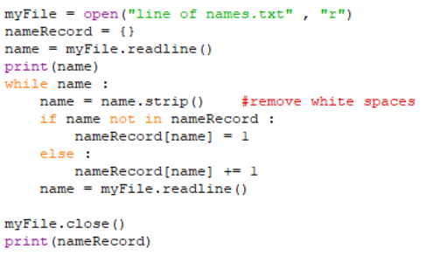
DICTIONARY CHALLENGE
# The line above strips away any white space (including \n) before and after the line of text in your file.
# Some reminders of how to open, close and read a file.
LO 3.5 students should be able to structure and transform raw data to prepare it for analysis
Notes:
The extra challenge here is reading the file. Some code to read a file is given in the slide.
It would be a good idea to get rid of all white space when reading from a file. The .strip() method will strip white space (including newline) from a string.
Otherwise the challenge is similar to the “dictionaries and lists” challenge.

Slide 19
Learning Review
From this lesson I am able to:
Understand the concept and use of a dictionary
Look up KEYS and VALUES in a dictionary
Create, Add and Delete items from a dictionary
Read from a file and store data in a dictionary
Analyse strings of data
Notes:
Students will be testing out simple dictionary methods and properties during the lesson, and reading files.

