Slide 1
Learning to Program in Python
Concept 7
Definitions
(with Turtles)
Notes:
Functions in Python are called Definitions.
The KEY question for this lesson should be : Why use functions at all?
The lesson should provide the answers: 1. Through the task and 2. Explicit reasons why functions are essential to efficient, readable code and CT skills

Slide 2
Learning Intentions
From this lesson the students will be able to:
Use definitions to control Turtle behaviour
Notes:
Using previous challenges and new challenges, students should be able to draw shapes and control Turtle behaviour, using a modular approach.

Slide 3
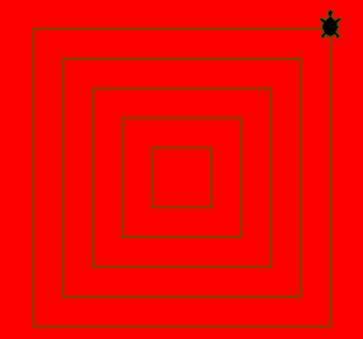
REVISIT a loopy Challenge
REMEMBER this challenge using for loops.
To use for loops in Turtle graphics to create a pattern of 5 concentric squares.
Notes:
Recap on how these concentric squares were drawn.

Slide 4
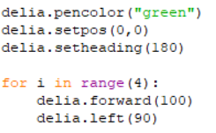
REMEMBER this mini CHALLENGE
Delia draws a SQUARE using a for loop.
Notes:
Drawing a Square can be abstracted into a definition.

Slide 5
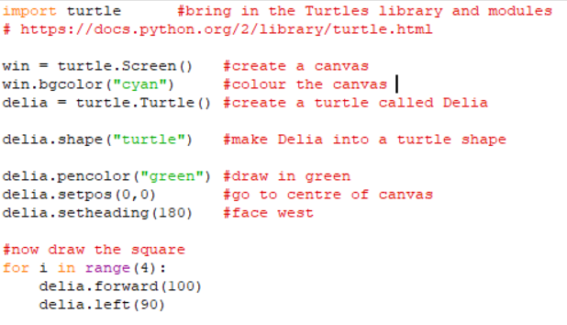
Here’s how Delia’s code might fit in to a program
Notes:
Students may want to type this into their IDE or reading through it may be enough.

Slide 6
Modify the program to include a definition
The code below could be replaced by a definition.
Can you modify the previous program to include a function which draws Delia’s square, starting at the centre of the canvas?
Notes:
The PRIMM method will encourage engagement. (Predict Run Investigate Modify Make)
Once students have created a definition to draw a square, they can incorporate it into an overall program.
(An outline of how they might incorporate the definition follows in the next slide.)

Slide 7
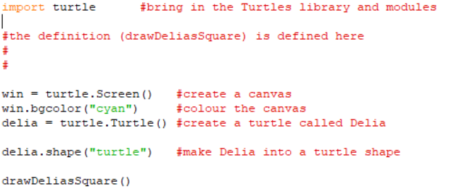
Including a definition – Sample Code
LO 2.3 students should be able to implement modular design to develop hardware or software modules that perform a specific function
Notes:
The PRIMM method will encourage engagement. (Predict Run Investigate Modify Make)
Once students have created a definition to draw a square, they can incorporate it into an overall program.

Slide 8
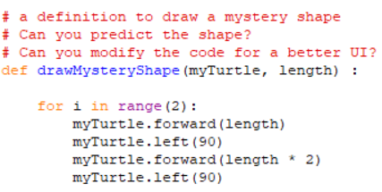
Predict what this definition will draw?
Notes:
The PRIMM method will encourage engagement. (Predict Run Investigate Modify Make)

Slide 9
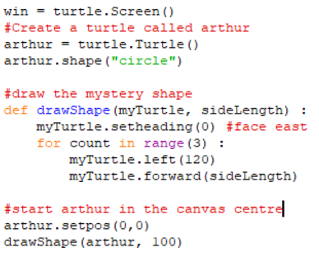
Predict what this definition will draw?
LO 1.6 students should be able to explain the operation of a variety of algorithms
Notes:
The PRIMM method will encourage engagement. (Predict Run Investigate Modify Make)

Slide 10
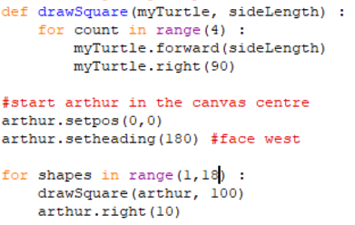
Predict what arthur will draw
LO 1.22 students should be able to read, write, test, and modify computer programs
Notes:
The PRIMM method will encourage engagement. (Predict Run Investigate Modify Make)
This program should be read, written and modified to create a circle within the series of squares.

Slide 11
Learning Review
From this lesson I am able to:
Use definitions to control Turtle behaviour
LO 3.9 students should be able to analyse and interpret the outcome of simulations both before and after modifications have been made
Notes:
Students should be able to read definitions and see their impact on the behaviour of agents that are modelled.

