Slide 1
Learning to Program in Python
Concept 7
FUNCTIONS
(Definitions)
Notes:
Practice and principles of good programming. The intention of these slides over several classes is to engage in tasks suing definitions.
The KEY question for this lesson should be : When to use functions?
The lesson should provide the answers: 1. Through the tasks and 2. Explicit reasons why functions are essential to efficient, readable code and CT skills

Slide 2

Learning Intentions
From this lesson the students will be able to:
Create definitions
Pass parameters to definitions
Design solutions using their own definitions
Notes:
The intention of this lesson is for students to solve as many problems as possible using definitions and in the process learning more about what defintions can do.
Also students will be revising previous concepts such as variables, loops, lists and dictionaries. Choose the puzzles and tasks that suit the level of the students.

Slide 3
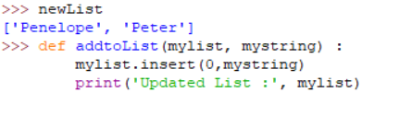
Passing Variables to a Definition
Predict what the definition above will do when called.
Notes:
Encourage the students to predict what each line in the body of the definition will do, and how you would call this definition.

Slide 4
Passing Variables to a Definition
The function is passed a list and a new element for the list. (These are the inputs, or parameters, of the function. In this case mylist and mystring)
The new element is added on to the start of the list, and the list printed out.
The general syntax is : def function_name(parameters):
Notes:
Encourage the students to predict what each line in the body of the definition will do, and how you would call this definition.

Slide 5
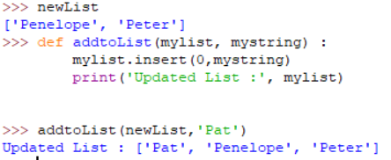
Call Me
Go to your IDE and try defining the function.
Pass a few more parameters to it to lengthen the list.
You can also append a new element to the end of the list.
LO 1.22 students should be able to read, write, test, and modify computer programs
Notes:
Encourage the PRIMM concept of reading and modifying the code. (Predict Run Investigate Modify Make)
In this case, the students could append instead of insert. Or perhaps do both, so the list is topped and tailed with the new element.

Slide 6

Create Your Own
Create a list containing the names of 2 famous people. For example : [“Lincoln” , “Yeats”]
Write a program, using definitions, that allows the user to add more elements to the list.
The definition should update the list and print it out each time it is updated.
The user wants to add between 1 and 10 people to the list. The user must be asked the number of new people they want to add.
LO 2.6 students should be able to construct algorithms using appropriate sequences, selections/conditionals, loops and operators to solve a range of problems, to fulfil a specific requirement
Notes:
As an extension to this exercise, some groups of students could be asked to write definitions to add or remove an element.
The user could then be asked what they want to do regarding the list.
The Scratch symbol indicates that this task should also be done in Scratch (or similar block-based language). The html resource, containing the Scratch program and guiding the students, is part of the same folder as this Python resource, on the ncca.ie website. Encourage the students to edit this html code with their work and reflections as part of their ePortfolio.

Slide 7
FUNCTIONS
We can pass in as many parameters to a function as we like:
  def fancyNumberOfInputs(a, b, c, x, y, z)
BUT we can only ever have one (if any) return from a function.
https://docs.python.org/3/library/functions.html ...... Gives a list of Python built-in functions.
Notes:
The definitions to open or close a file, e.g. myFile = open(“Dbfamouepeople.txt”,’w’), are good examples of definitions we have used that are pass multiple inputs (or parameters)

Slide 8

Return my Call
The command return sends back the variable to wherever the function was called.
(usually in the main program)
Notes:
What data type will be returned from the halveMe function?
It is a float because of the division by 2.

Slide 9
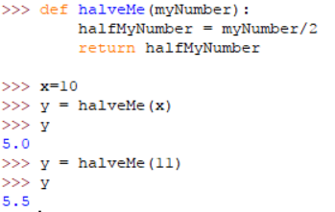
Return my Call
Try it out. Change the function to perform a different task, such as doubleMe.
Notes:
The output is clearly of type float, as shown above.
Encourage students to tweak this definition to another similar one. E.g. trebleMe and subtract 2.

Slide 10
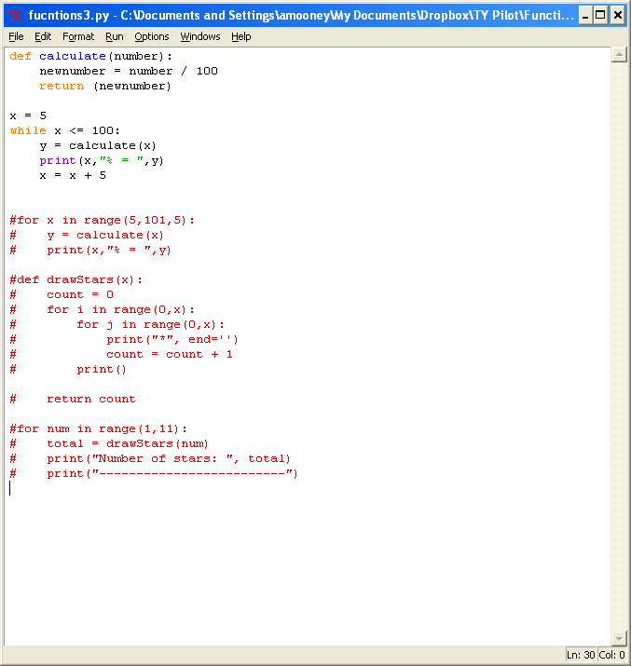
ONE way or another
Predict what this program will do when executed.
Notes:
Encourage students to Think Pair and Share their predictions, and then write the program in their IDE to check their predictions.

Slide 11
ONE way or another
We have a definition called calculate() which is called from inside the loop.
Calculate() takes in a number and divides that number by 100, returning the answer to the loop.
The function converts a percentage to its number equivalent e.g. 15% = 0.15
Notes:
Encourage students to Think Pair and Share their predictions, and then write the program in their IDE to check their predictions.

Slide 12
Create your Own
A Classic Example
Create a function to convert a number given in degrees Celsius to its Fahrenheit equivalent.
Call your definition celToFah().
Its input is a temperature in degrees Celsius.
The formula for conversion is :
Fah = (9 * Cel) / 5 + 32
The UI should clearly state the input and the converted output.
Notes:
Encourage paired programming and students testing and evaluating each other’s programs and UIs.

Slide 13
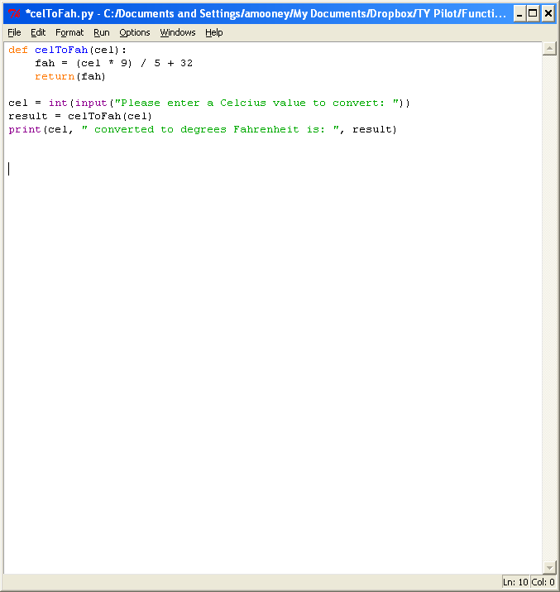
Sample Code
LO 2.7 students should be able to implement algorithms using a programming language to solve a range of problems
Notes:
A skeletal example of what some code might look like.
Ask the students what they would do to enhance this program. For example, add comments, print out statements explaining what the program does, allow decimals and thus cast the input as float, etc…..

Slide 14
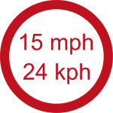
CHALLENGE
Write 3 programs, using definitions, that offer a User Interface to do the following conversions :
  Convert miles to kilometres.
  Convert kilometres to miles.
  Converts in both directions!
  (Clue for definition 3 : One of the input parameters should tell your function which conversion to do. For example, if it is a Boolean variable, and called miles2kilometres, then if it is true the conversion is from miles to kilometres. If it is false, it is km to miles.)
Notes:
The first two conversions are similar to the previous slides.
The third one is similar to the exercise in the first lesson on functions (The 5 step algorithm) where the 3rd and 4th steps were handled by one function.
In the case of the 3rd definition above, a Boolean variable is described. E.g def convertDistance(distance, miles2kilometres) :
It could be called in the following way …. Distance = convertDistance(48, True) …

Slide 15
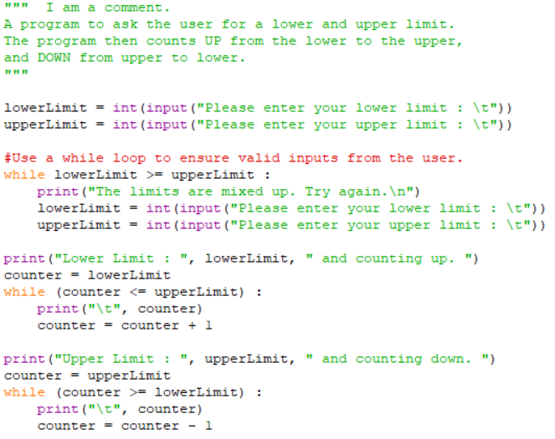
The following task was completed during While loops.
The Scratch challenge is to get the countDOWN and countUP numbers scrolling across the screen.
What line of code is behind me?
Notes:
This extension of this lower and upperLimit counting task can be completed in Scratch. So as the numbers go from say 10 to 11 to 12, these numbers must scroll across the screen from left to right and then from right to left during the countdown. There must be a use of definitions during the task.
The Scratch symbol indicates that this task should also be done in Scratch (or similar block-based language). The html resource, containing the Scratch program and guiding the students, is part of the same folder on functions as this Python resource.

Slide 16

A previous Challenge from the Dictionary Lessons
Let’s say we have a string “dictionaries and lists”
We need to count how many times each letter appears in the string.
The information for each letter must be stored, easily accessed and also printed out.
Using ThinkPairShare, design an algorithm and pseudo code to solve this problem.
LO 1.7 students should be able to develop algorithms to implement chosen solutions
Notes:
In the NCCA resources on understanding Dictionaries, this example was studied.
Encourage students, in pairs, to brainstorm (coggle might help here) on the algorithm and flow of their program, before writing any code.
If using Cheat Sheets, encourage students to use them.
One of the NCCA examples for ALT2 (Analytics) analyses the words in a txt file in a similar fashion.

Slide 17
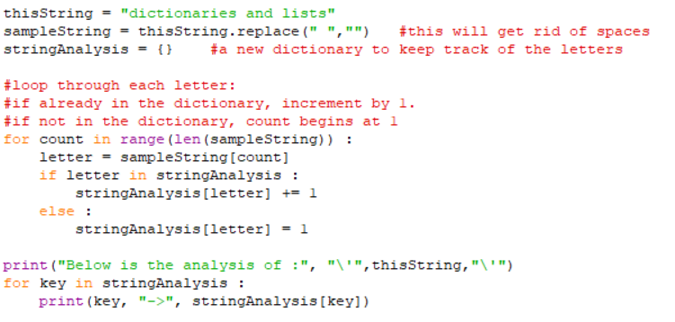
Sample code from
Previous Letter Count Challenge
Notes:
The sample code strips out white spaces (Cleans the data). This is optional. Also, the first for loop could be made more concise by using : for letter in sampleString :
Students will now be asked to enhance their program by using definitions, and for example, asking the user for a string to analyse..

Slide 18
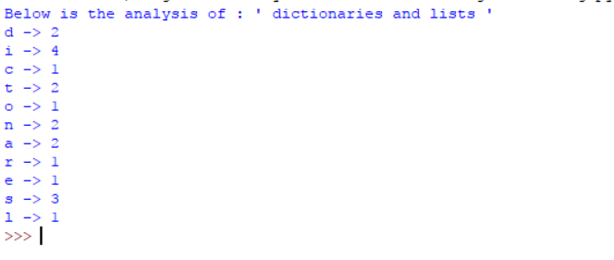
Enhancing the
Letter Count Program
Using the sample code or otherwise, write a program that:
  Uses definitions to
    ask the user for a string
    clean the string of spaces and count the letters in the string
    print the analysis in a clear readable format.
  If using the sample code, can you use less lines of code to perform the same task?
  .
LO 3.5 students should be able to structure and transform raw data to prepare it for analysis
Notes:
The task is to enhance the program to analyse a string for recurrence of the same letters, using different definitions for each subtask.
The previous slide’s sample code will output as shown above.

Slide 19
Learning Review
From this lesson I am able to:
Create definitions
Pass parameters to definitions
Design solutions using my own definitions
Notes:
Students should becomePractice and principles of good programming. The intention of these slides over several classes is to engage in tasks suing definitions.
The KEY question for this lesson should be : When to use functions?
The lesson should provide the answers: 1. Through the tasks and 2. Explicit reasons why functions are essential to efficient, readable code and CT skills

