Slide 1
Learning to Program in Python
Concept 6
LISTS
(and dictionaries)
Notes:
Lists are a form of data type or data structure. They are similar to arrays in other languages. LISTS are a very powerful feature of Python.
They are considered to be one of the key Threshold Concepts in learning how to Program.
The tasks and ideas would require several classes to ensure students have time to engage with the concept.

Slide 2
Learning Intentions
From this lesson the students will be able to:
  Understand the concept of a list
  Retrieve and Replace elements
  Append and Remove elements from a list
  Get the length of a list.
  Begin the process of creating a basic database for a user and allowing the user greater control.
Notes:
Students will be testing out simple list methods and properties during the lesson. It will feel very similar to the section on STRINGS for the basic methods.
The main Learning Outcomes (LO) achieved are highlighted throughout the lesson and tasks.
The list is not exhaustive, and consultation with the LCCS spec is encouraged at all times throughout the implementation of the course.

Slide 3
LISTS
Often, in programming, we need to store data in a way we can easily access and modify.
In most languages this is done with arrays or lists or similar.
In Python LISTS are used.
Here are some examples….
LO 2.16 students should be able to use data types that are common to procedural high-level languages
Notes:
Lists are Python’s form of Arrays.

Slide 4
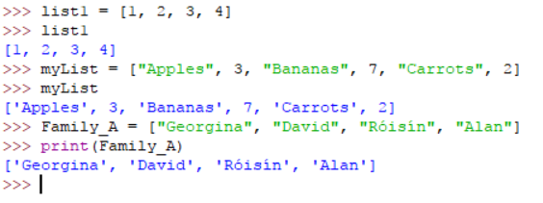
Creating LISTS
In your IDE, create and print some LISTS.
Notes:
Encourage students to type in these lists or similar ones of their own. What observations can they make?
For example, the data types in lists can be all the same or entirely different. This is highly flexible and very ‘Pythonic’.

Slide 5
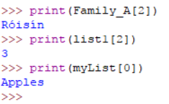
Individual elements of a LIST
Try these in your IDE. Can you figure it out?
Notes:
Encourage students to figure out how the index of a list works.
For example, why is Roisin number 2 in the Family_A list?
What observations can be made?

Slide 6
What are LISTS?
A list is a sequential collection of values (called elements) where each value is identified by an index.
The FIRST index is ZERO.
(very common in lists, arrays, strings..)
Notes:
Emphasise the first index is ZERO and lists are a form of data structure

Slide 7
Python LISTS
[The simplest way to create a list in Python is to enclose the elements in square brackets].
The elements of a list do not have to be of the same type.
Notes:
Emphasise the first index is ZERO and lists are a form of data structure

Slide 8
Creating & Printing Lists is Easy
In Python we can create a list and save it with a name:
newList = [1, 2, 3, 4]
We can print the contents of our list:
print(newList)
As usual, to see what you can do in Python, consult your Cheat Sheet or just Google your query.
Notes:
Encourage the students to look up what functionality is possible, as often as possible.

Slide 9

Create Your Own
1. Create a list containing the following integers: 2, 4, 8, 16, 32
  Give your list the name: my_integers
  Print out the contents of the list
2. Create a list containing the names of 5 class members, including your own name:
“Liam”, “Honora”, etc….
  Give your list the name: csClassNames
  Print out the contents of the list
LO 2.18 students should be able to collect, store and sort both continuous and discrete data
Notes:
The list my_integers will be used in the slides that follow to probe LISTS in more depth.

Slide 10
Accessing my Lists
Try these commands on your IDE
Using your list : my_integers = [2,4,8,16,32]
To retrieve the first element : myFirstElement = my_integers[0]
To retrieve the second element : mySecondElement = my_integers[1]
LO 1.22 students should be able to read, write, test, and modify computer programs
Notes:
The variable myFirstElement will be assigned the first element, which has the value 2.

Slide 11
Accessing my Lists
Try these commands in your IDE
my_integers = [2,4,8,16,32]
One way to get last element :
myLastElement = my_integers[-1]
To make a sublist from the 2nd element to the last and see what is in it:
subList = my_integers[2:]
print(subList)
This is known as SLICING a list.
What do you think is in this subList ?
Notes:
SLICING : subList = my_integers[2:] is an example of slicing a list

Slide 12
List Index Notation
myList = [‘P’, ‘Y’, ‘T’, ‘H’, ‘O’, ‘N’]
0 | 1 | 2 | 3 | 4 | 5
P | Y | T | H | O | N
-6 | -5 | -4 | -3 | -2 | -1
myList[4] == myList[-2] == “O”
myList[1:3] == myList[-5:-3]
myList[-1] == myList[len(myList) - 1] == “N”
Notes:
Encourage the students to experiment. The similarities to accessing strings are clear, given String Index Notation encountered in the Strings lesson.

Slide 13
Adding to my Lists
After each command print the list to verify.
my_integers = [2, 4, 8, 16, 32]
To add another element : my_integers.append(46)
OR
my_integers = my_integers + [46]
OR
my_integers += [46]
Notes:
Encourage students to add to a list using assignments (a = a + [2]) rather than methods a.append(46).
It is often more reliable within a program.

Slide 14
Modifying my Lists
After each command print the list to verify.
my_integers = [2, 4, 8, 16, 32, 46]
To change an element : my_integers[5] = 64
To delete an element (using an index) :
del my_integers[3]
To remove a value in the list : my_integers.remove(2)
Notes:
LISTS are MUTABLE so the element can be changed using the index, as shown above. (STRINGS are IMMUTABLE)
APPEND and REMOVE are powerful methods for LISTS

Slide 15
a = [1, ”Ger”, 2, ”Robin”] b = [3, 6, 9, 12]
Index | a[2] * b[-1]
Slice | c = b[1:] print(c)
Append | a = a + [3, “Phil”] print(a)
Assign | a[1] = “Gerry” print(a)
Append | b += [15, 18, 21] print(b)
Delete | del b[3] print(b)
In or Out | print(15 in b)
Try Me ! | d = a[::-1]
Hint : Slice the list in steps of -1
Notes:
The word descriptions of the operations are important. (Slice, Assign, Append etc….)
Encourage students to predict the outcomes. The PRIMM method will encourage engagement. (Predict Run Investigate Modify Make)
The assignment and concat are useful for the solution to the next challenge.

Slide 16
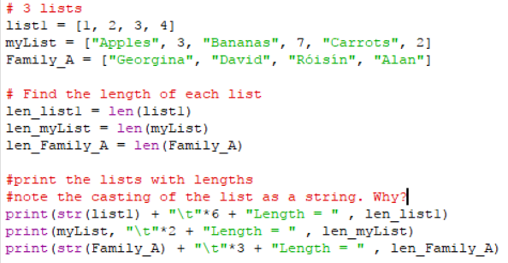
Length of Lists
Read and Modify …. very similar to Strings
Notes:
No new ideas here if strings have been studied.
Note that in the first print statement, list1 has to be cast as a string, for the concatenation with the rest of the strings that follow, to work properly.
The second print statement doesn’t need to cast myList because it is not concatenated to the strings that follow.

Slide 17
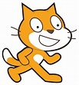
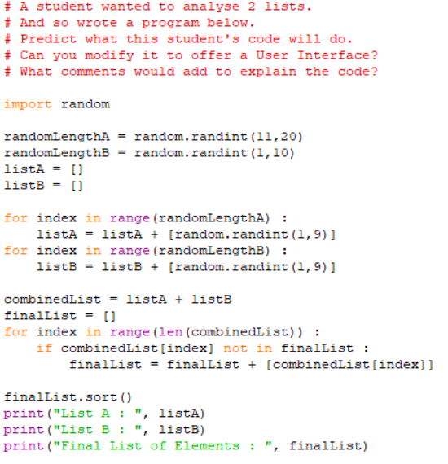
Notes:
Encourage the students to type in this code, save in a file in their storage space, and edit and experiment.
A good classroom exercise is to ask students to write the pseudocode using a Think-Pair-Share framework.
The program outputs a list of elements that are in one or both lists, removing duplication between the pair of randomly generated lists, listA and listB.
The Scratch symbol indicates that this task should also be done in Scratch (or similar block-based language). The html resource, containing the Scratch program and guiding the students, is part of the same folder as this Python resource, on the ncca.ie website.

Slide 18
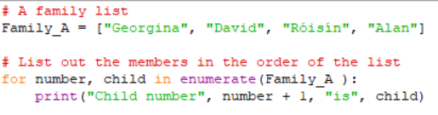
Lists and a Loop - An Example
Predict what this code will do.
Take note of the structure for x,y in ….
Enumerate is a Python command that allows you to get the index and element at the same time.
LO 1.2 students should be able to explain how the power of computing enables different solutions to difficult problems
Notes:
PREDICT the outcome of the code.
The PRIMM method will encourage engagement. (Predict Run Investigate Modify Make)

Slide 19

CHALLENGE
Write a program that
  Asks the user their name
  Asks the user their age & country of birth
  Stores the info in a list called userList.
  Prints out the info in a readable format.
  Writes the info to a file …. recall how to write to a file below …
Notes:
This is closely related to the introductory lesson on Functions … whyFunctions … where a bigger database is built.
NOTE The line “ “.join(userList) will create one string from the elements of the list, with a space between each element.
Encourage the students to look up how the join method works. To split up a string into a list, the split() method will do the work.

Slide 20
Some sample Code
userList=[]
userName = input(“What is your Name?“)
userList.append(userName)
userAge = input(“What age are you,“, username, “?”)
userList.append(userAge)
userCountry = input(“What is your country of birth?”))
userList.append(userCountry)
..
..
print(“My database for”, username, “\n”, userList)
# ‘\n’ adds a new line
# Can you print the userList in a more readable format than this ?
LO 1.6 students should be able to explain the operation of a variety of algorithms
Notes:
This is one way of asking the user for their information

Slide 21
Remember this Looping Challenge
We need to get 5 random numbers between 1 and 100.
Your program must ask 5 different users and tell the user their position in the queue (i.e. 1st number or 2nd number etc.)
You had to enhance the program with a for loop.
The program was saved as : Five_Random_Numbers v1.py
LO 1.21 students should be able to identify alternative perspectives, considering different disciplines, stakeholders and end users
Notes:
REVISIT REVIEW RE-DESIGN EXERCISE
The original task in the for loop lesson was designed for students to write the code to ask one user, then replicate the code, with some minor adjustments, to ask the next user.
The idea was to create in the student the need for a better way to program this task – namely a need for a FOR loop.
Now having studied LISTS and LOOPS, students should be able to design a similar program with far greater functionality, giving the user more choice, storing the user data, and so on.

Slide 22
A new Five Random Numbers Challenge
REVISIT
Look again at this program.
How would you now store the user information?
REVIEW
Discuss how to use LISTS and LOOPS to enhance the functionality of such a program. For example, you may want to let the user decide how many random numbers they want to enter.
RE-DESIGN
Modify the program and ensure it executes correctly.
LO 2.20 students should be able to identify and fix/debug warnings and errors in computer code and modify as required
Notes:
This set of exercises is aimed at the design process to encourage students to reflect upon how to create better, more efficient artefacts.

Slide 23

Five Random Numbers CHALLENGE
Write an algorithm, using pseudo code
Implement the algorithm in code
You must use LISTS and LOOPS to enhance the design.
Save your program as : Five_Random_Numbers v2.py
LO 1.7 students should be able to develop algorithms to implement chosen solutions
LO 2.5 students should be able to use pseudo code to outline the functionality of an algorithm
Notes:
Some sample code using LISTS and a basic for loop follows in the next slide.
Having revised writing out to a file in this lesson, some students could be encouraged to output the information in the lists to a file, similar to the preceding challenge on gathering name, DOB, county of birth data.

Slide 24
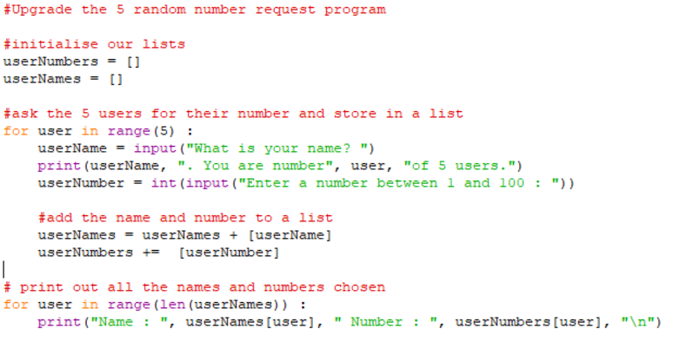
Sample Code
Notes:
Some code using a FOR loop to ask for 5 random numbers : Once students have written and tested their loops, some additional code is needed to store the random numbers in a list and print out that list. To challenge students who have completed something similar to the above, ask them how they could improve the program further.
For example checking if the user enters a number between 1 and 100 or allowing the user to decide how many random numbers they want to enter into the program.

Slide 25
Lesson Review
As a result of this lesson I am able to:
  Understand the concept of a list.
  Retrieve and Replace elements.
  Append and Remove elements from a list.
  Get the length of a list.
  Begin the process of creating a basic database for a user and allowing the user greater control.
LO 1.1 students should be able to describe a systematic process for solving problems and making decisions
Notes:
The last learning intention achieved will be built upon as lessons develop. Basic database building will be developed in lessons on functions.
Applied Learning Task 1 requires students to use a relational database.

