Slide 1
Learning to Program in Python
Concept 1
VARIABLES
Notes:
Variables will have been used in the starter program.
This is a full introduction to variables and data types, and a second lesson introduces operators.

Slide 2
Learning Intentions
From this lesson the students will be able to:
Assign Variables
Use Data Types
CAST variables
LO 2.16 students should be able to use data types that are common to procedural high-level languages
Notes:
A variable is allocated some memory in which data is stored. Students will learn how to store different types of data within a named variable.
The main Learning Outcomes (LO) achieved are highlighted throughout the lesson and tasks.
The list is not exhaustive, and consultation with the LCCS spec is encouraged at all times throughout the implementation of the course.

Slide 3
Previously we looked at how to write a program to …..
1. Ask the user of your program for their age.
2. Add 100 to their age.
3. Print out their age in 100 years.
LO 1.22 students should be able to read, write, test, and modify computer programs
Notes:
A very first program / algorithm to perform a very simple task.

Slide 4
Remember this first program
1. Ask the user of your program for their age.
2. Add 100 to their age.
3. Print out their age in 100 years.
Notes:
A very first program / algorithm to perform a very simple task.
Lines 1 and 2 assign values to variables.

Slide 5
Assigning a Variable
1. Ask the user of your program for their age.
userAge is an example of a Variable.
We could have called it User_Age or ageOfStudent. It is up to the programmer.
In Python, input from the user is in the form a STRING.
Notes:
Ask students for another suitable name for the variable.
Emphasise that it must be a continuous set of letters, with no spaces allowed.

Slide 6
Assigning a Variable
A variable is a piece of memory that stores a value.
The name of the piece of memory is the name of the variable. (userAge for example)
myVar = 17
The equals sign means assign.
(store the value on the right (17) in the variable on the left(myVar))
Notes:
Ask students for another suitable name for the variable myVar.
Emphasise that it must be a continuous set of letters, with no spaces allowed.

Slide 7
Variables
2. Add 100 to their age.
Name the 2 variables above.
newAge and userAge
are the 2 variables.
Notes:
Ask the students if we could replace the 100 with a variable and what would we call it?

Slide 8
Variables store Data
2. Add 100 to their age.
newAge and userAge store different types of data. How do you think they are different?
userAge stores data in the form of a STRING.
newAge stores data in the form of an INTEGER.
LO 2.18 students should be able to collect, store and sort both continuous and discrete data
Notes:
The variables store 2 different data types.

Slide 9
4 most common DATA TYPES
A STRING is a data type for characters (“A” or “1”)
An INTEGER is a data type for whole numbers (-2 or 45).
A FLOAT is a data type for decimal numbers.
(3.14 or -10.93).
A BOOLEAN is a data type for True or False.
LO 2.16 students should be able to use data types that are common to procedural high-level languages
Notes:
The reason they are underlined is these are the built-in functions for CASTing variables to different data types.
So int(x) casts x as an integer, str(c) casts c as a string, float(y) casts y as a floating number, and bool(p) casts p as a Boolean data type.

Slide 10
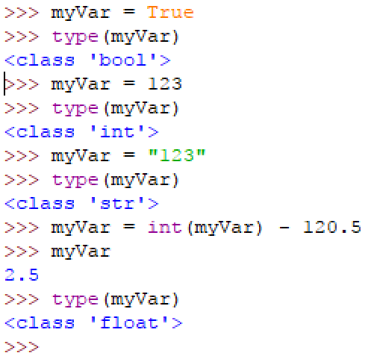
type(x) gives you the DATA TYPE
Notes:
Students may want to type this into their IDE or reading through it may be enough.

Slide 11
Variables store different Types of Data
2. Add 100 to their age.
Why do you think int(userAge) is needed above ?
userAge is a STRING int(userAge) is an INTEGER
Notes:
userAge is a STRING. Casting it as an integer means we can add on 100. Then newAge will be interpreted by Python as an Integer.

Slide 12
Fill in the Data Type of the assigned variable
- can you predict the value in each case ? -
Q | Code | Variable Data Type
0 | var1 = 10 | INTEGER
1 | var2 = 3.14 | FLOAT
2 | myVar = var1 + var2 | FLOAT
3 | var1 = True | BOOLEAN
4 | myVar = “123” | STRING
5 | myVar = int(var2) | INTEGER
6 | myVar = myVar + 3.14 | FLOAT
7 | myVar = str(var1) | STRING
8 | myVar = myVar + 3.14 | ? Be Careful ?
Notes:
The worksheet above can be downloaded from the website, completed by the students and stored in their online space.
Or it can be printed out for a written class task. The PRIMM method will encourage engagement. (Predict Run Investigate Modify Make)
The answers are revealed when the slide show is run.

Slide 13
Correct order but Remove INT()
1.
2.
3.
PREDICT what happens when INT() is removed around userAge on line 2, as shown above.
Notes:
Ask students to predict the error. Then students can modify their program.
There are 2 KEY lessons to draw from this error.
Python reads input from the user as text. Even numbers look like text/characters/strings to Python.
INT() changes the input from the user to an integer. INT stand for integer. This is known as CASTING a variable.

Slide 14
PYTHON and Data Types
Python can switch data types really easily …
it is known as CASTING a variable.
userAge = int(userAge)
What do you think this line will change with regard to the variable userAge?
Notes:
userAge = int(userAge) will CAST userAge as an integer, and change its data type from string to integer.

Slide 15
Predict what this code will print?
What number will print?
Notes:
Encourage students to try it out in their IDE. The key is that the value in myNumber is overwritten by its original value plus 2.

Slide 16
This program will output 2 lines. Predict the 2 lines.
Notes:
Encourage students to try it out in their IDE. The key is that the value in myNumber is overwritten twice. Also the syntax of myNumber += 3 is important.

Slide 17
How do you know how to write correct PYTHON?
Consult your Cheat Sheet
Google “python 3.6 cheat sheet”
Or search for Python style guides
Notes:
Students need to be able to find lots of their own answers.

Slide 18
How do you know how to write correct PYTHON or find out how to do stuff?
Some of the recommended sites for writing Python….
1. docs.python.org … tutorial
2. Runestone Academy - How to Think Like a Computer Scientist
3. Stack Overflow
Notes:
A resourceful student is an extra teacher and one less student.

Slide 19
REVISIT - FIRST PROGRAM CHALLENGE
0. Ask the user of your program for their name.
1. Ask the user for the year they were born.
2. Calculate their age this year.
3. Print out a message with their name and age in the message.
Notes:
If the students haven’t done this previously, set it now as a task.

Slide 20
optional CHALLENGE
Write the program using only variables
(The number 2018 not allowed)
0. As before ..
1. As before …
2. 2018 – Google “python how to get the current year”
3. As before … but watch your variable names in line 2.
LO 1.2 students should be able to explain how the power of computing enables different solutions to difficult problems
Notes:
A solution is given below. Encourage students to find and modify the code so the program uses the current year, and never goes out of date.
from datetime import datetime
thisYear = datetime.now().year
# check we have the right year and correct syntax
print("current year", thisYear)

Slide 21
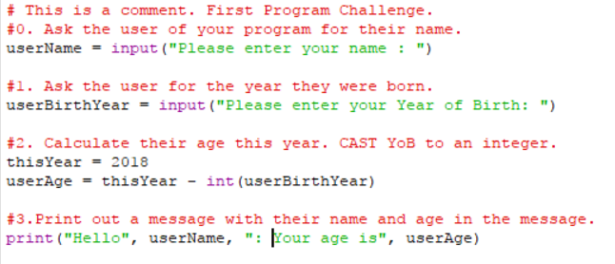
Sample Code for (enhanced) First Challenge
CHANGE THIS LINE OF CODE
Notes:
Sample Code to carry out the task required in the enhanced First Program Challenge on the previous slides.
Point out that Python ignores anything written after a hash symbol. (#This is ignored by Python.)

Slide 22
Learning Review
From this lesson I am able to:
Assign Variables
Use Data Types
CAST variables
Notes:
Students should become comfortable at assigning and casting variables, and have an understanding of DATA TYPES.

