Slide 1
Learning to Program in Python
Concept 5
LOOPS
(while loops)
Notes:
These tasks are a continuation of the concepts learned in the for loops section.
The tasks and ideas would require several classes to ensure students have time to engage with the concept.

Slide 2
Learning Intentions
From this lesson the students will:
Understand the concept of a while loop and the difference between a while and for loop
Write code to implement a while loop
Challenge themselves with using a while loop to input and verify data from a user
Notes:
The concept of while loops is learned through tasks and introducing new ideas.
The main Learning Outcomes (LO) achieved are highlighted throughout the lesson and tasks.
The list is not exhaustive, and consultation with the LCCS spec is encouraged at all times throughout the implementation of the course.

Slide 3
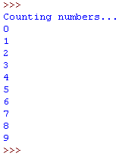
The while Loop in Python
Can you predict what the output will be ?
Note: The value held in i must be set by you and incremented (or increased) by you.
Try it on your IDE.
LO 1.4 students should be able to solve problems using skills of logic
Notes:
Using a sandwich technique, first see what students understand by a while loop.
One of the key features of Python, and why it has become so popular, is its immediate readability and ease of comprehension.

Slide 4
A new Concept : Conditional LOOP
A while loop will continue iterating (looping) as long as some condition is true
while i is less than 10 do the following commands
print i and increase i by 1
Notes:
À while loop closely resembles an if statement, but instructions are executed until the condition is satisfied.

Slide 5
while loop v for loop
A for loop will continue to execute until all statements in a block (one lap of the running track) have been executed a certain number of times.
The for loop will increment the counter automatically
How is a while loop different to a for loop, as described above?
Notes:
A while loop will only continue to execute WHILE something is true or false.
The programmer must increment or decrement the counter.

Slide 6
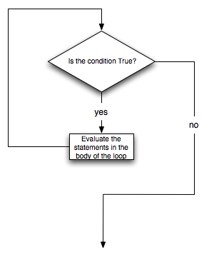
while loop Flow
Flow Chart starts here
What happens if the condition is always true?
Will it ever come out of the loop?
Execute your code
Exit the loop
Notes:
A FLOW chart representation …. An infinite loop is raised here…….while True : always do the following.

Slide 7
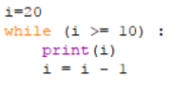
while loop
The previous example increased our variable by 1 and began at a value of 0.
What if we want to start at 4? Try it.
What if we want to start at 20 and count down to 10? Try it.
LO 1.22 students should be able to read, write, test, and modify computer programs
Notes:
Ask students to predict before they write it into their IDE or IDLE.
The PRIMM method will encourage engagement. (Predict Run Investigate Modify Make)

Slide 8
while loop in Python
Can you foresee any UI problems with asking the user for the start and end values?
Read this program and discuss what it is doing.
LO 1.23 students should be able reflect and communicate on the design and development process
Notes:
Ask students to predict before they write it into their IDE or IDLE. Spend a few minutes asking the students to think of problems with the User Interface of this program. For example, the counter decrements by 2. If the end value is greater than the start value will there be any output?
Or for example, there is no information to the user to tell them the program is counting down from the start to the end value.

Slide 9
Create Your Own
Write a program using a while loop that :
Starts at 0
Ends at 100
Increments in steps of 5, each multiple of 5 printed out to the screen.
Once completed, in pairs, include a UI that asks the user for a start and end value.
Ask a different pair to test your program for bugs or UI issues
LO 1.16 students should be able to compare two different user interfaces and identify different design decisions that shape the user experience (HL)
Notes:
The students’ first while loop written without sample code… highlight in particular the UI issues with a program of this nature.

Slide 10
Write code to produce the output OR
Predict the output for the given code.
 | Output | Code
1 | The numbers 1 to 10, each number on its own line.
2 | 16 14 12 10 8 6 4 2 with each number on its own line.
3 | 1 22 333 4444
4 | 4444 333 22 1
Assess Yourself
Assess Yourself
Assess Yourself
Assess Yourself
Notes:
ASSESS YOURSELF : Encourage students to predict the outcomes of the code, write the code and write their own code to produce the given outputs.
Understanding and Predicting these outputs are crucial to students attempting the challenge later in this lesson and the CT challenge on password strength.
The PRIMM method will encourage engagement. (Predict Run Investigate Modify Make)

Slide 11
while loop – testing 2 conditions
You want the user to enter a number between 20 and 80 (inclusive) and print out the number.
If the user enters a number outside this range, you want your program to prompt the user again for a valid input.
So the condition for an invalid number is …..
userNumber <20 or userNumber >80
Notes:
Introduction to 2 things : a more robust UI and the Boolean operator OR.
The OR operator is a logical operator. Links to LOs involving logic gates are included in related resources on the ncca website.
Ask the students to write an algorithm to accomplish this.

Slide 12
while loop – testing 2 conditions
Think of an algorithm, in pseudo code to, ask the user for valid number between 20 and 80.
ask the user for a number;
While user Number<20 or user Number>80 {
inform the user of an invalid number;
ask the user for another number;
}
Print out the user Number
LO 2.5 students should be able to use pseudo code to outline the functionality of an algorithm
Notes:
Introduction to 2 things : a more robust UI and the Boolean operator OR. Ask the students to write an algorithm to accomplish this, using pseudo code.
The challenge later in this lesson will require a more complicated algorithm.

Slide 13
Sample code – testing 2 conditions
LO 2.6 students should be able to construct algorithms using appropriate sequences, selections/conditionals, loops and operators to solve a range of problems, to fulfil a specific requirement
Notes:
It is important the students understand this example of testing validity before trying the class challenge.
The logical operator is self-explanantory in Python, but is worth drawing attention to .
Also, you could write : while userNumber >=20 and userNumber<=80 : …… in the process drawing attention to the and operator.

Slide 14
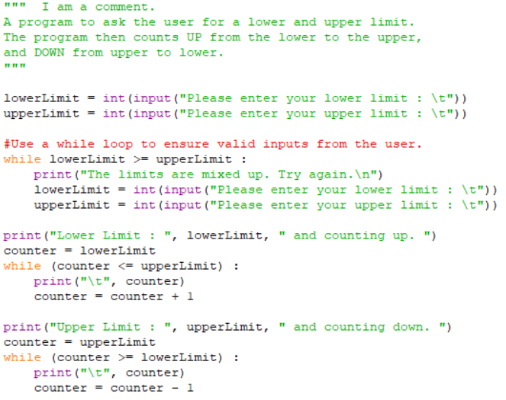
What line of code is behind me?
What lines of code could be behind me?
What line of code is behind me?
What line of code is behind me?
Notes:
This program will help students think about the Class Challenge, which is a task which follows at the end.
Once the class has figured out the hidden lines, encourage the students to type in this code, save in a file in their storage space, and edit and experiment.
Students need to read all the lines of code first to help figure out the names of variables, or what the variable counter is initialised to, etc.
The Scratch symbol indicates that this task should also be done in Scratch (or similar block-based language). The html resource, containing the Scratch program and guiding the students, is part of the same folder on while loops as this Python resource.
The next slide challenges the students to create a more complex User Interface.

Slide 15
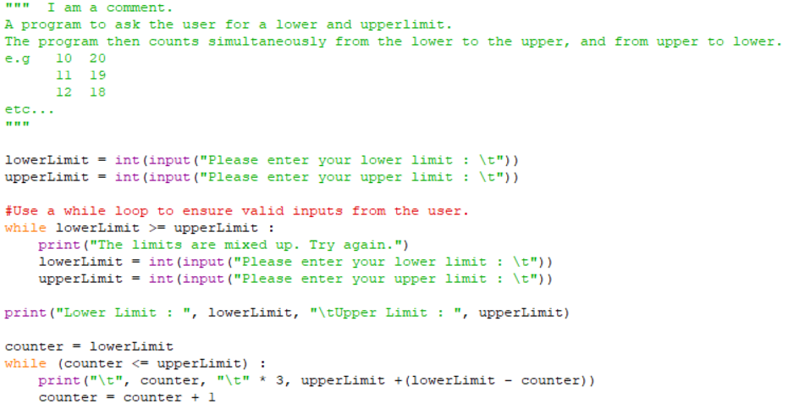
Create Your Own
Modify the previous upper and lower limit program to count up and down simultaneously.
The output should look like :
Lower Limit : 10 Upper Limit : 20
10 20
11 19
12 18 and so on ..
Notes:
A more challenging version of the lower and upper limit counting program written in the previous task. (HL)

Slide 16
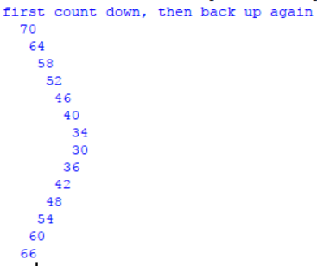
CLASS CHALLENGE
Implement a program with while loops that :
Counts down and up again between 2 values.
The counting must be done in steps chosen by the user i.e steps of 1 or 2 or 3 etc..
The sequence must be output to a txt file.
The full spec is on the next slide.
Notes:
The output from the challenge could look like this for a startValue of 70 and endValue of 30 and step of change of 6. Some of the code for the indented output is below.
print("first count down, then back up again")
count = 1
while i > endValue :
print(" “ * count, i)
i -= step
count += 1

Slide 17
CLASS CHALLENGE
Implement a program with while loops that :
Asks the user for an integer between 60 and 80. (startValue)
Asks the user for an integer between 20 and 40. (endValue)
Validates both inputs. (Ensures they are between the limits)
Asks the user for a stepValue.
The program counts down from the startValue to endValue (or closest value possible), and then counts up again from endValue to startValue (or closest value possible).
The counting numbers are output to the screen and stored in a txt file (or in a list).
LO 2.7 students should be able to implement algorithms using a programming language to solve a range of problems
Notes:
Encourage the students to write pseudo code first, before attempting to code it.
A sample output follows plus a program that will help students think about the challenge.

Slide 18
Lesson Review
As a result of this lesson I:
Understand the concept of a while loop and the difference between a while and for loop.
Can write code to implement a while loop.
Challenged myself with using a while loop to input and verify data from a user
Notes:
The main Learning Outcomes (LO) achieved are highlighted throughout the lesson and tasks.
The list is not exhaustive, and consultation with the LCCS spec is encouraged at all times throughout the implementation of the course.
The class challenge, fully completed using PAIRED programming or teams, would address considerably more LOs than those highlighted in the lessons and tasks.

